Slide 1
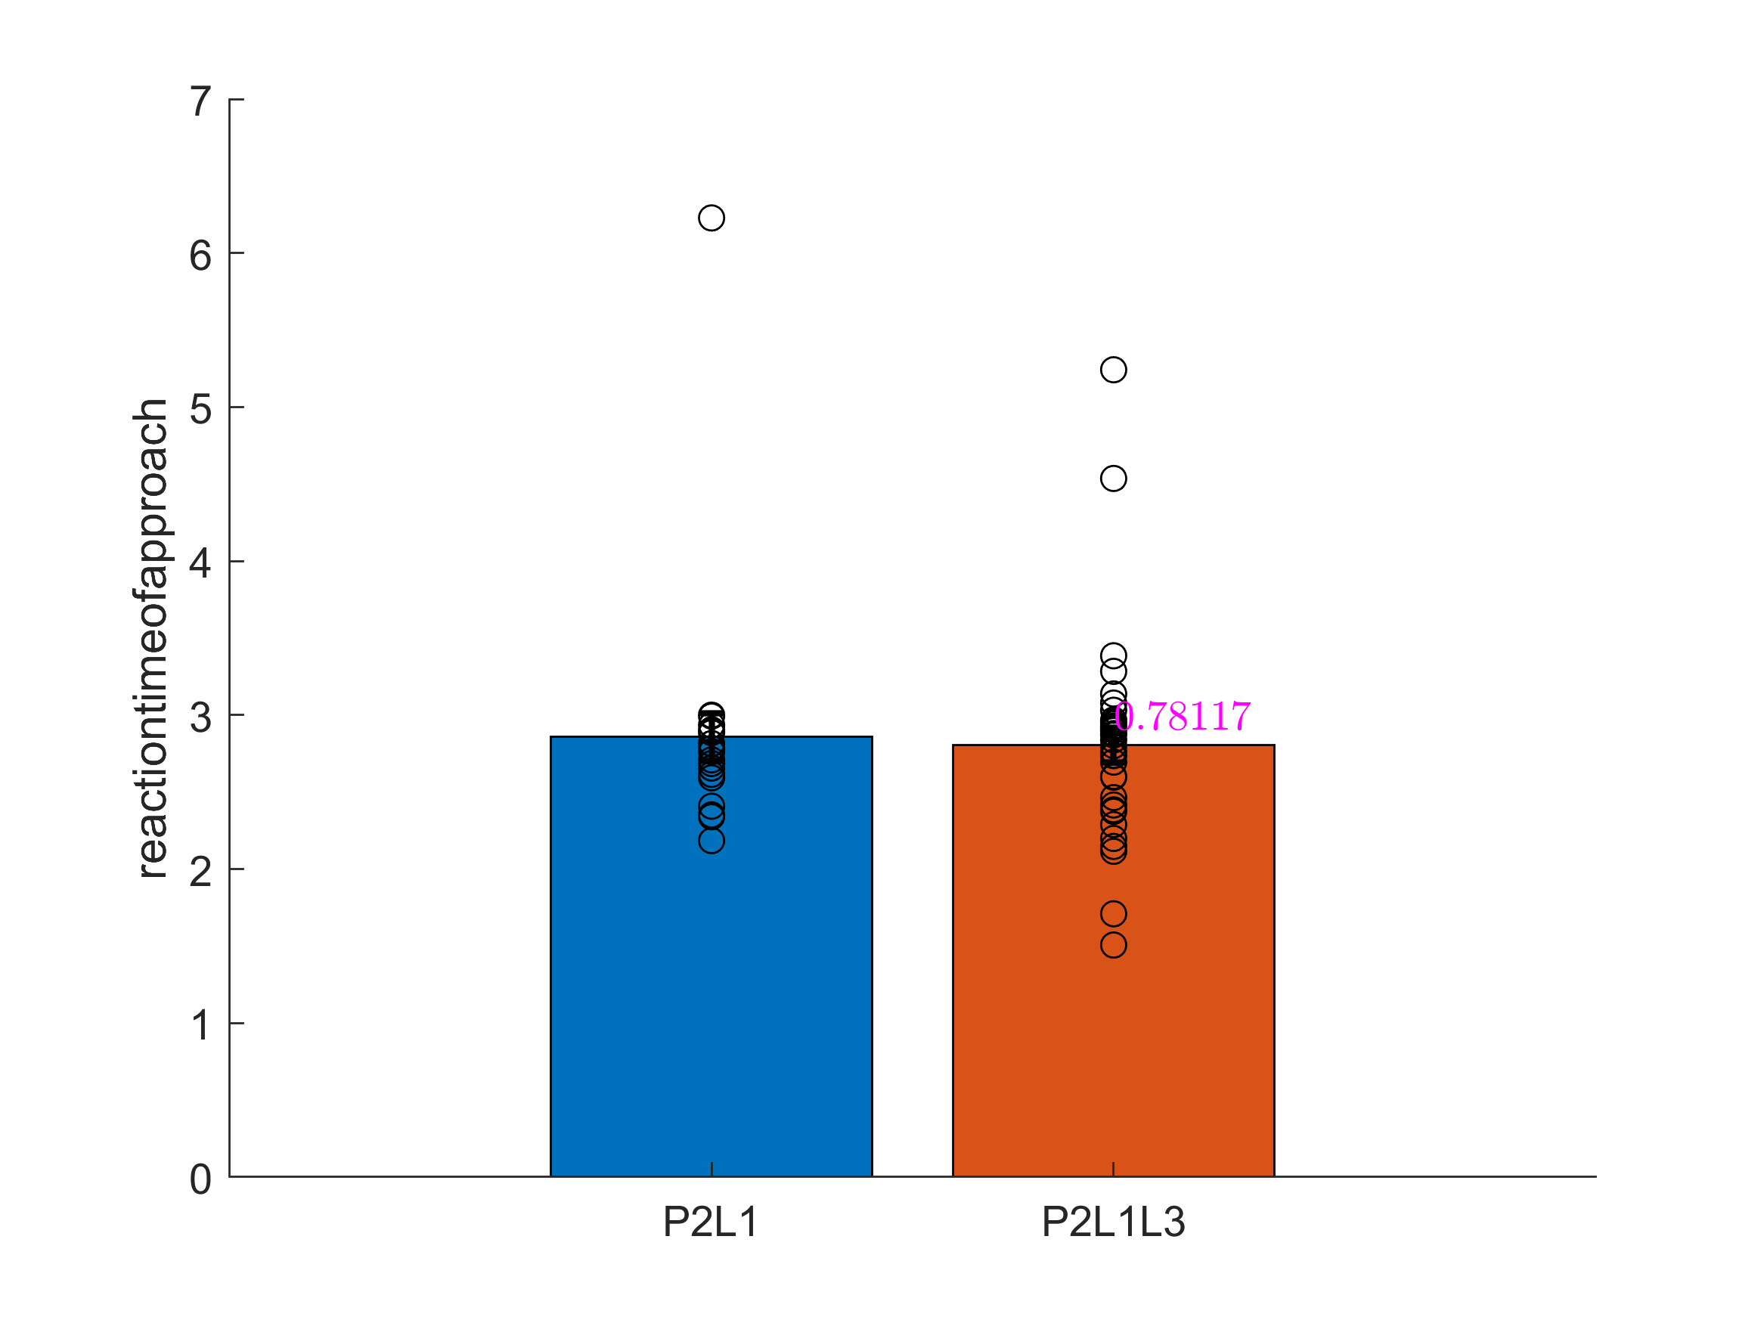
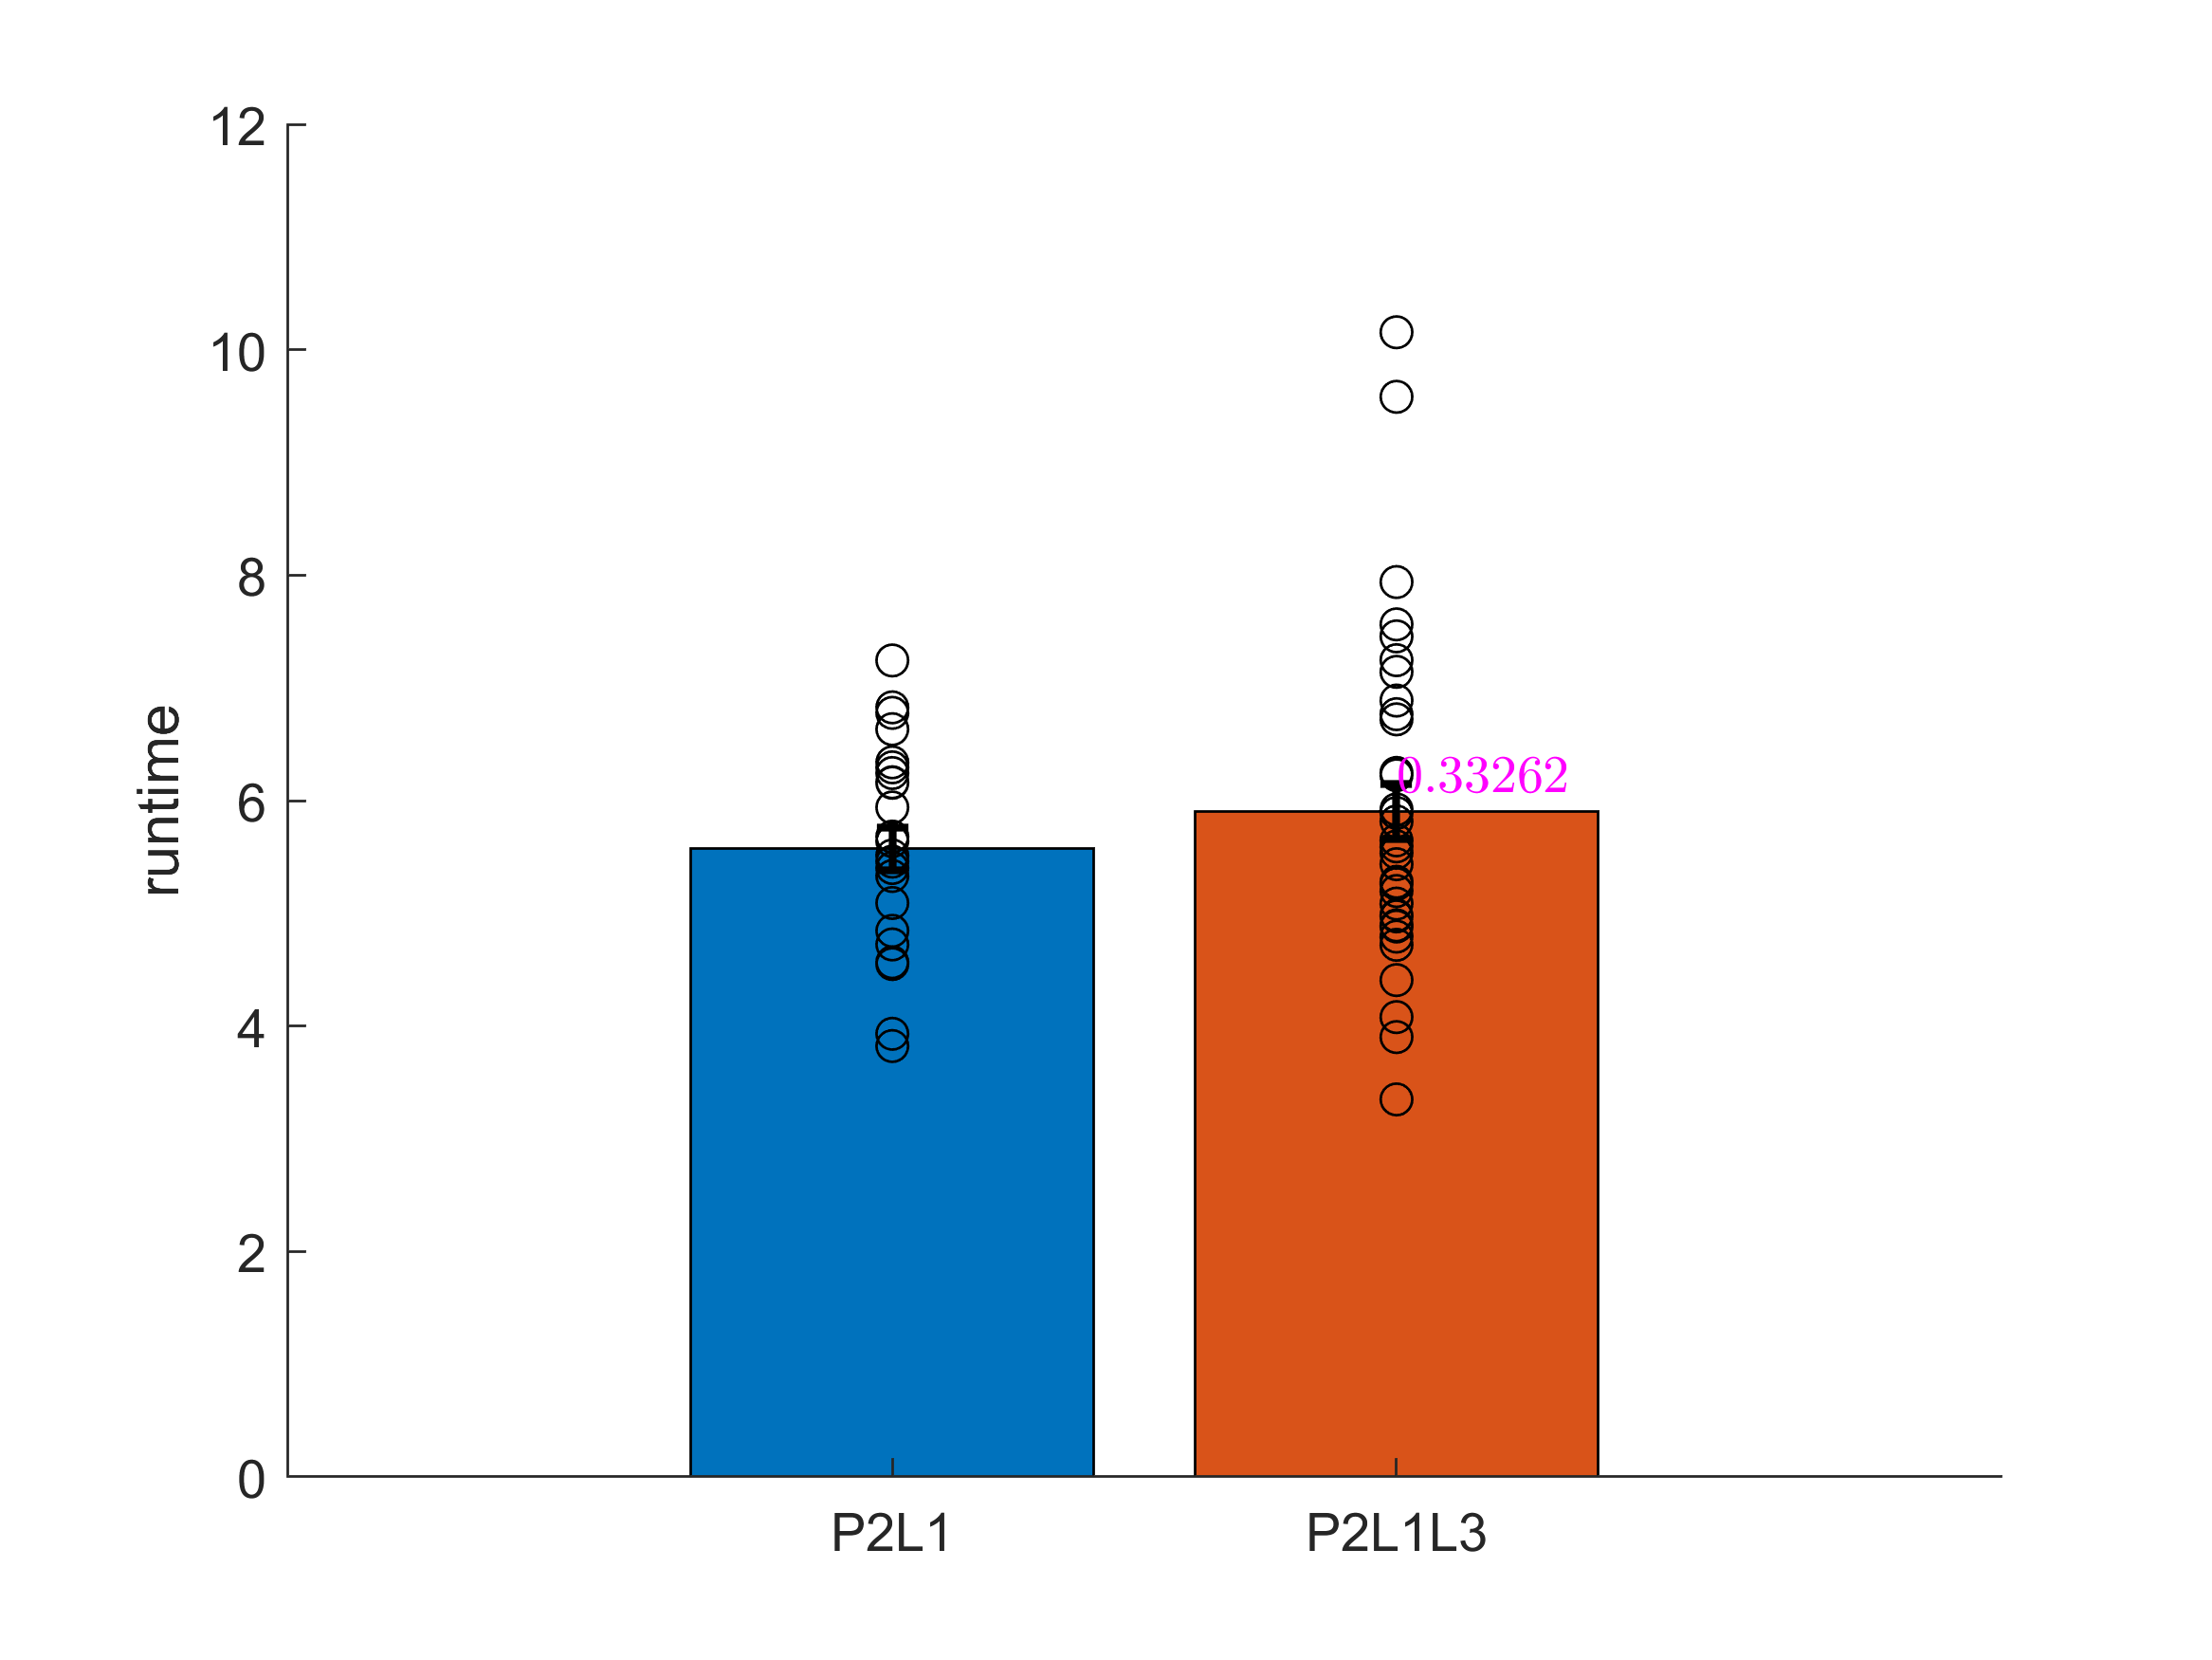
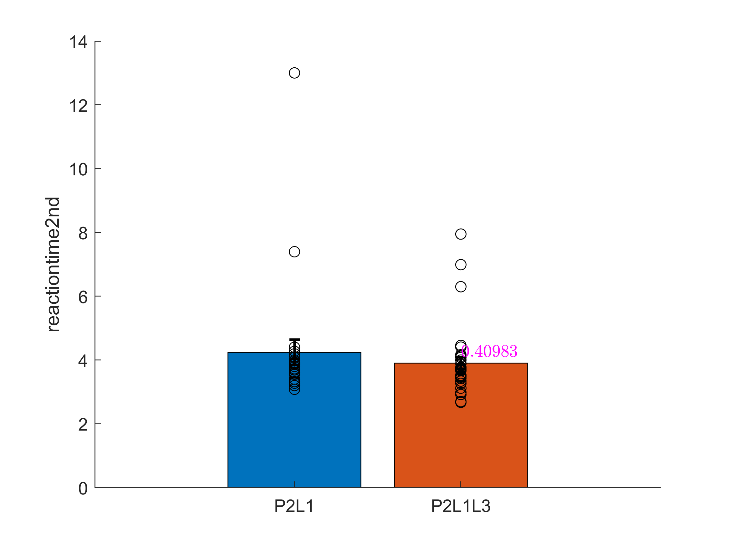
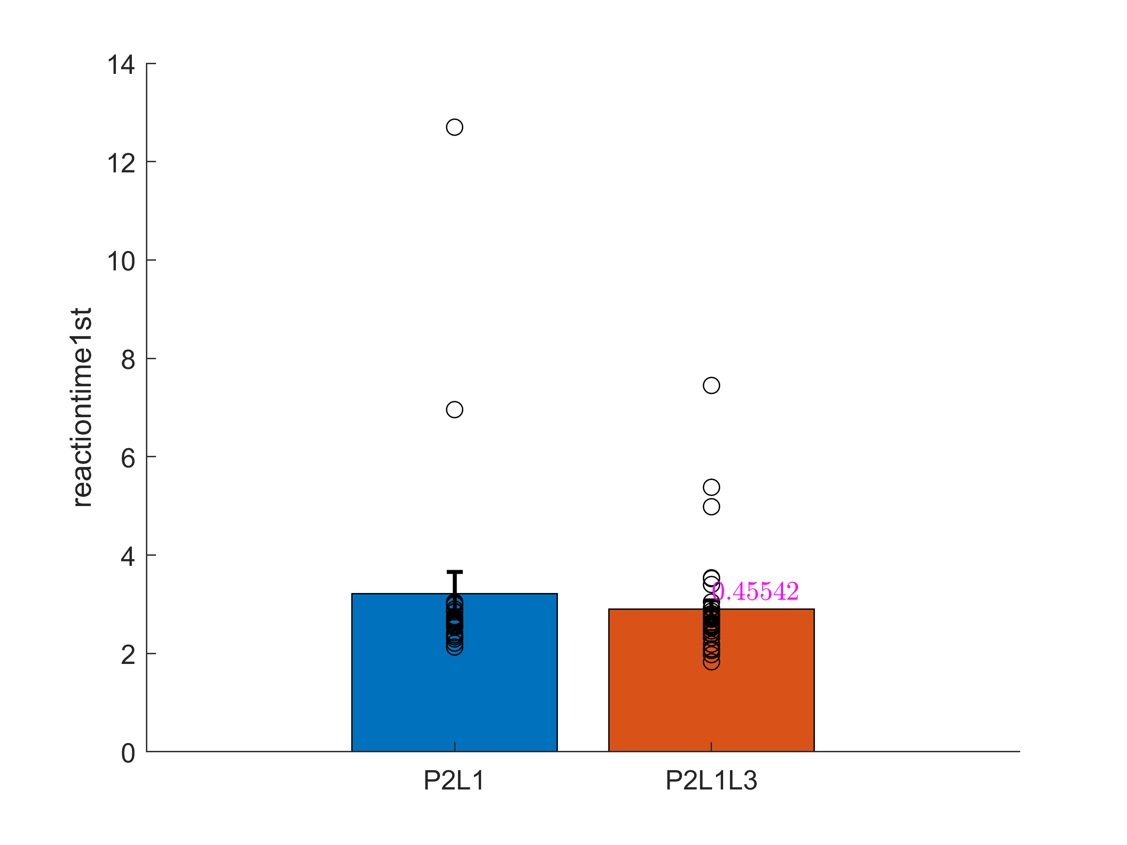
Notes:
Refer featureComparisonL1VsL3

Slide 2
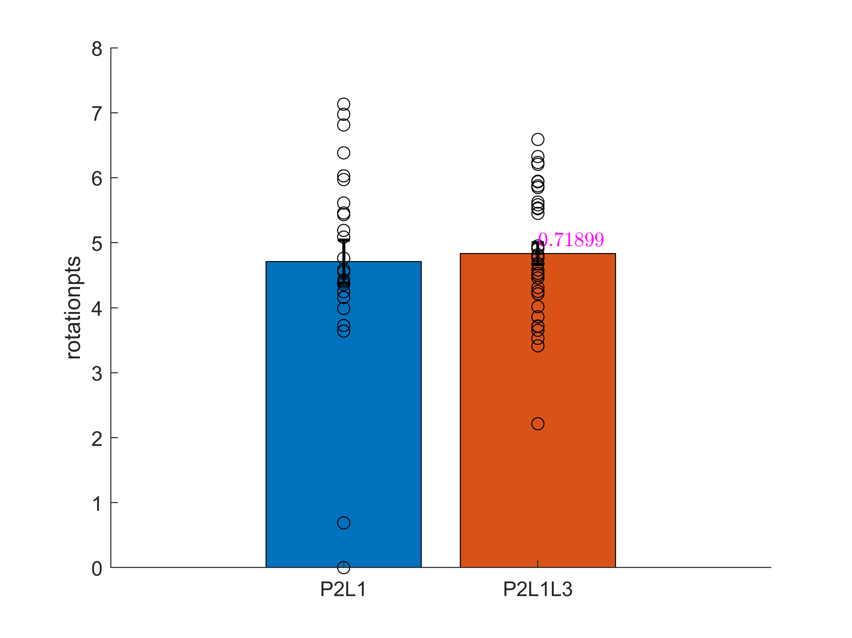
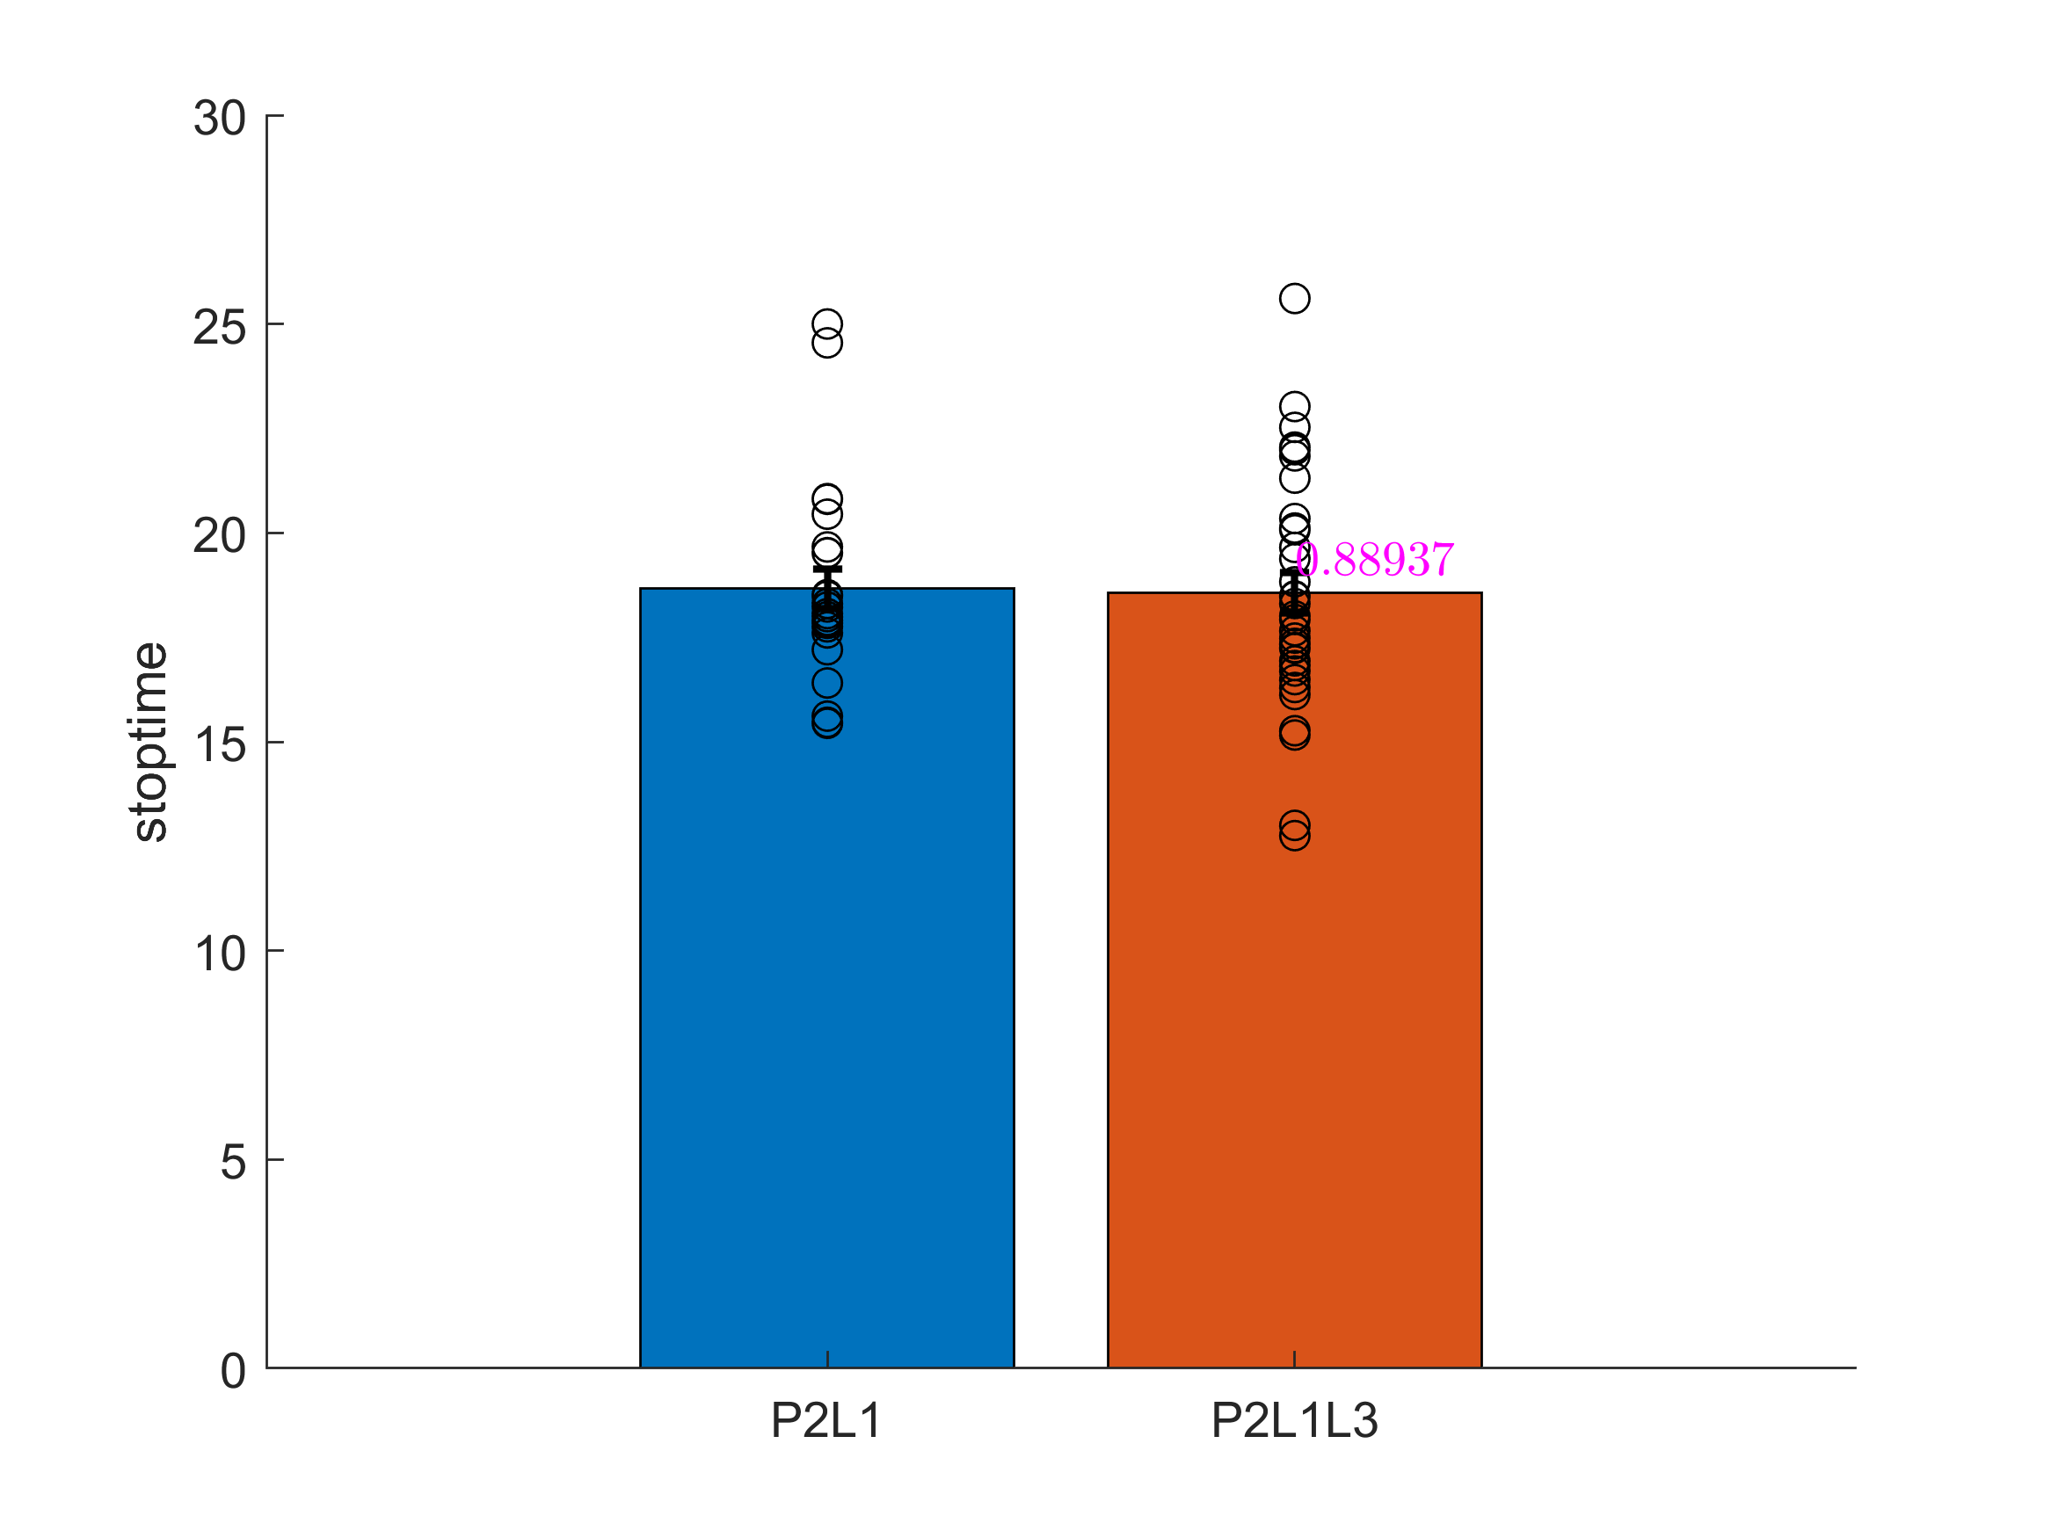
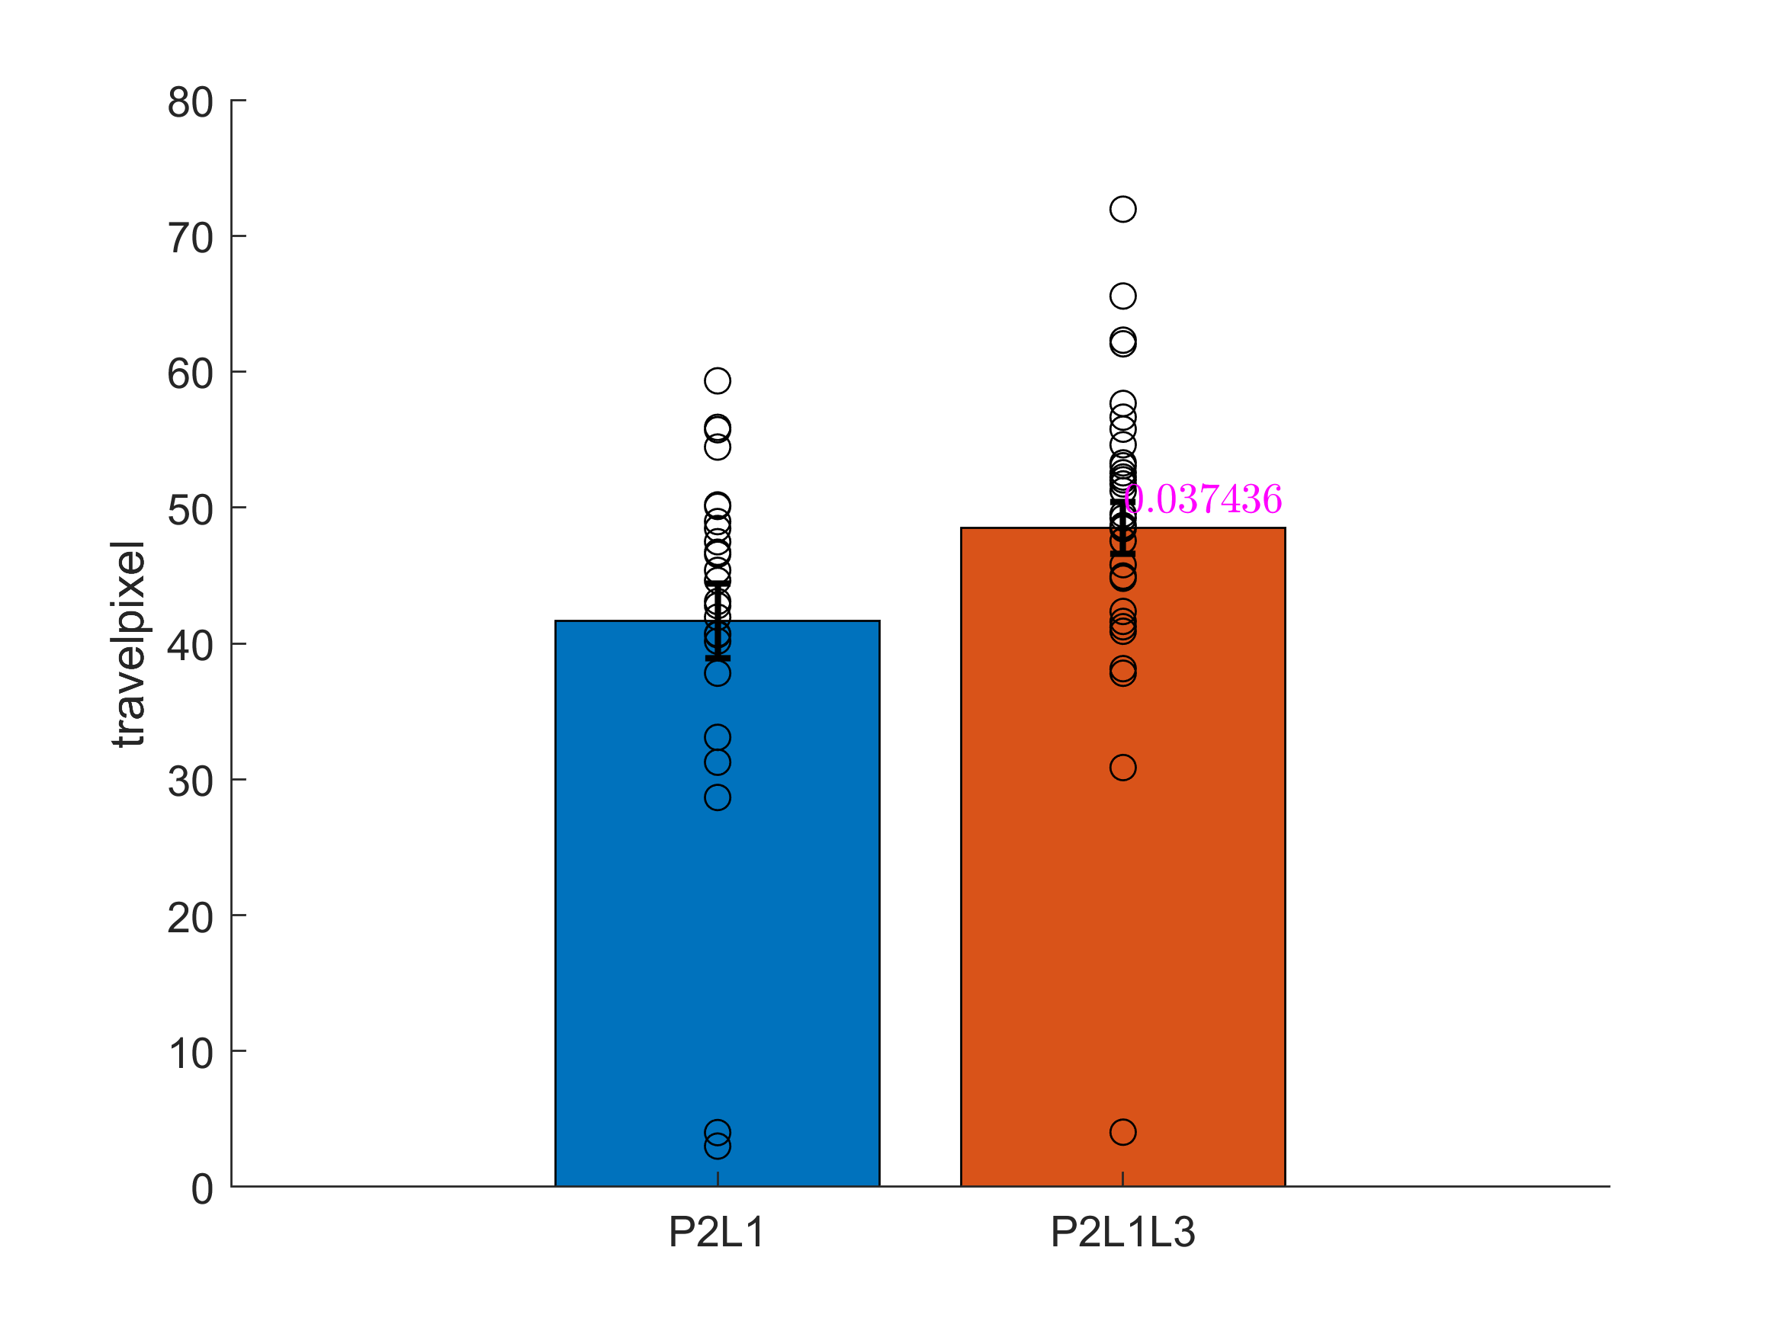
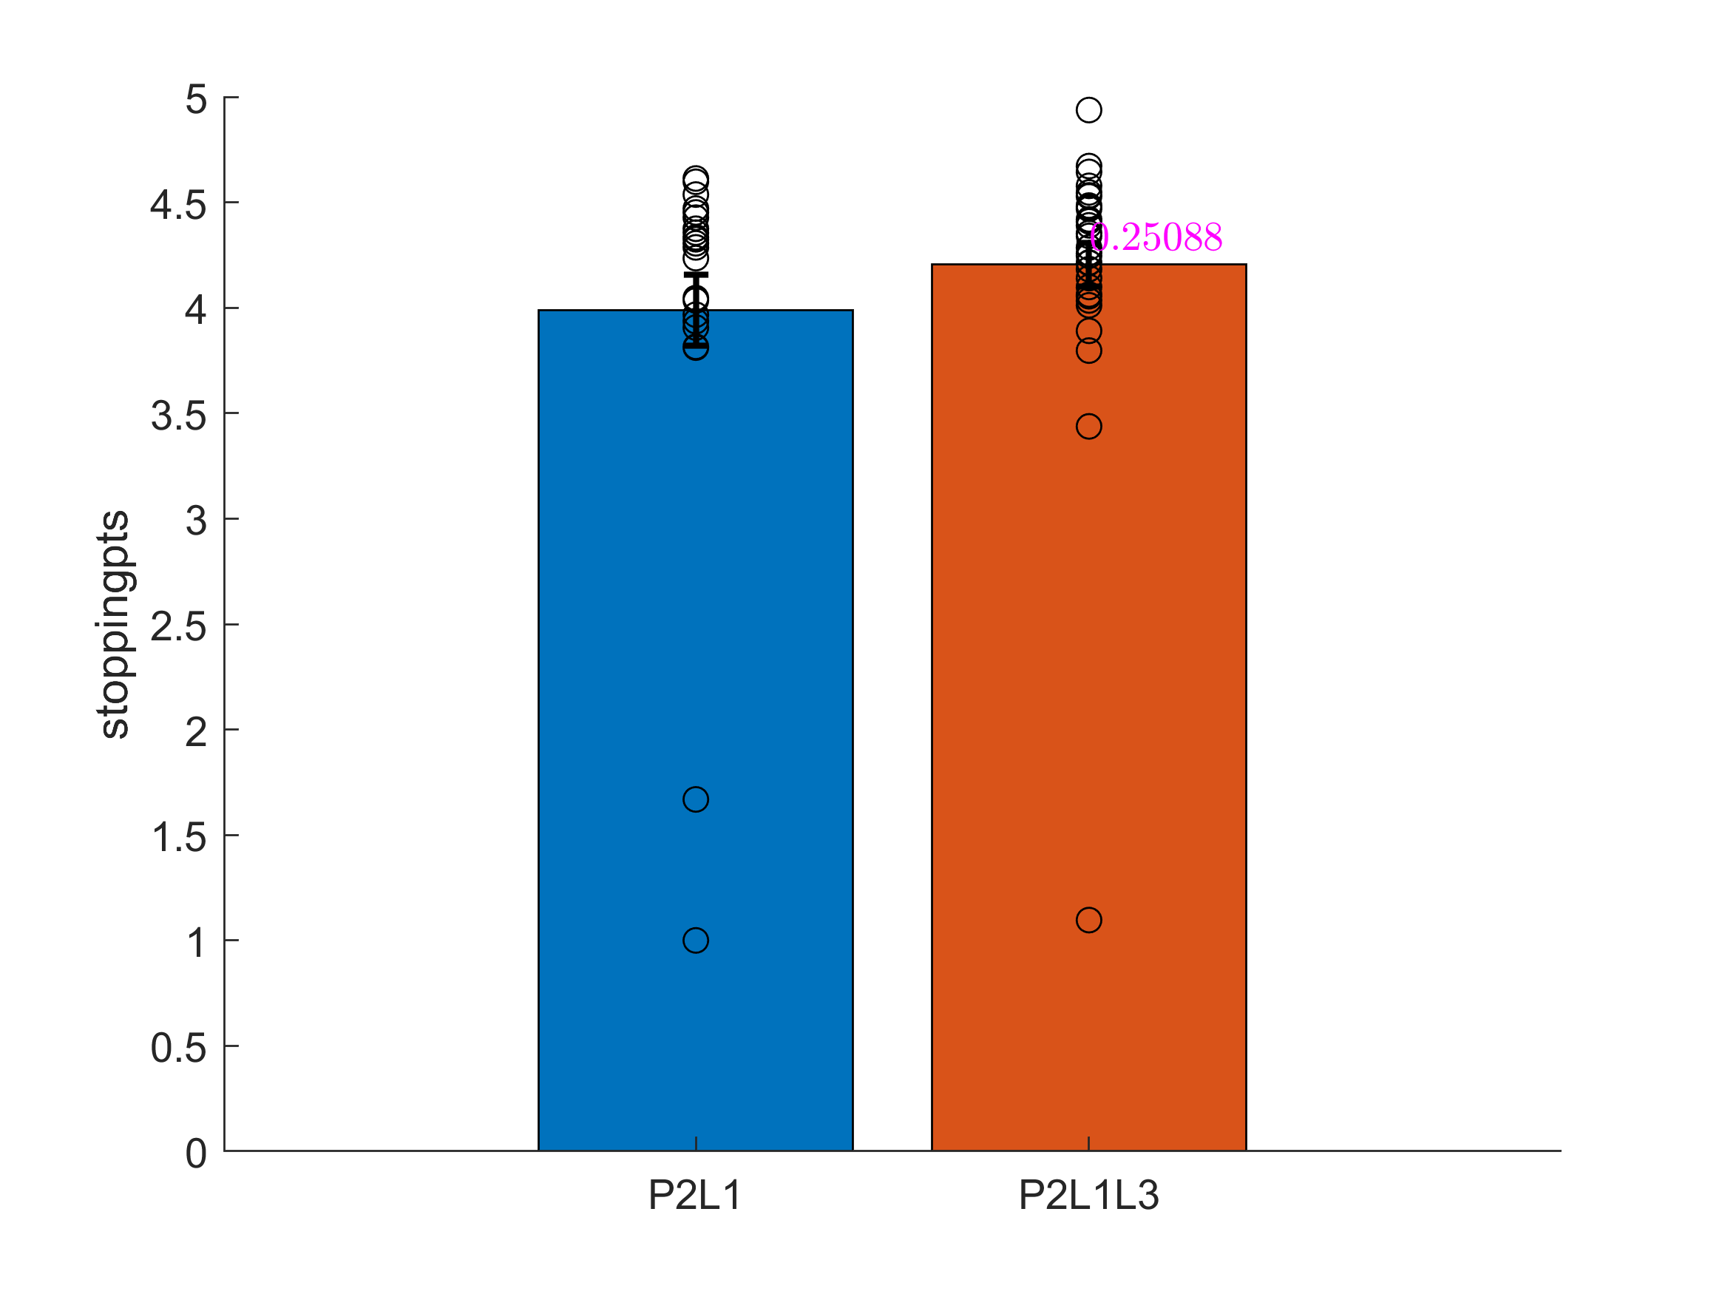
Notes:
Refer featureComparisonL1VsL3

Slide 3
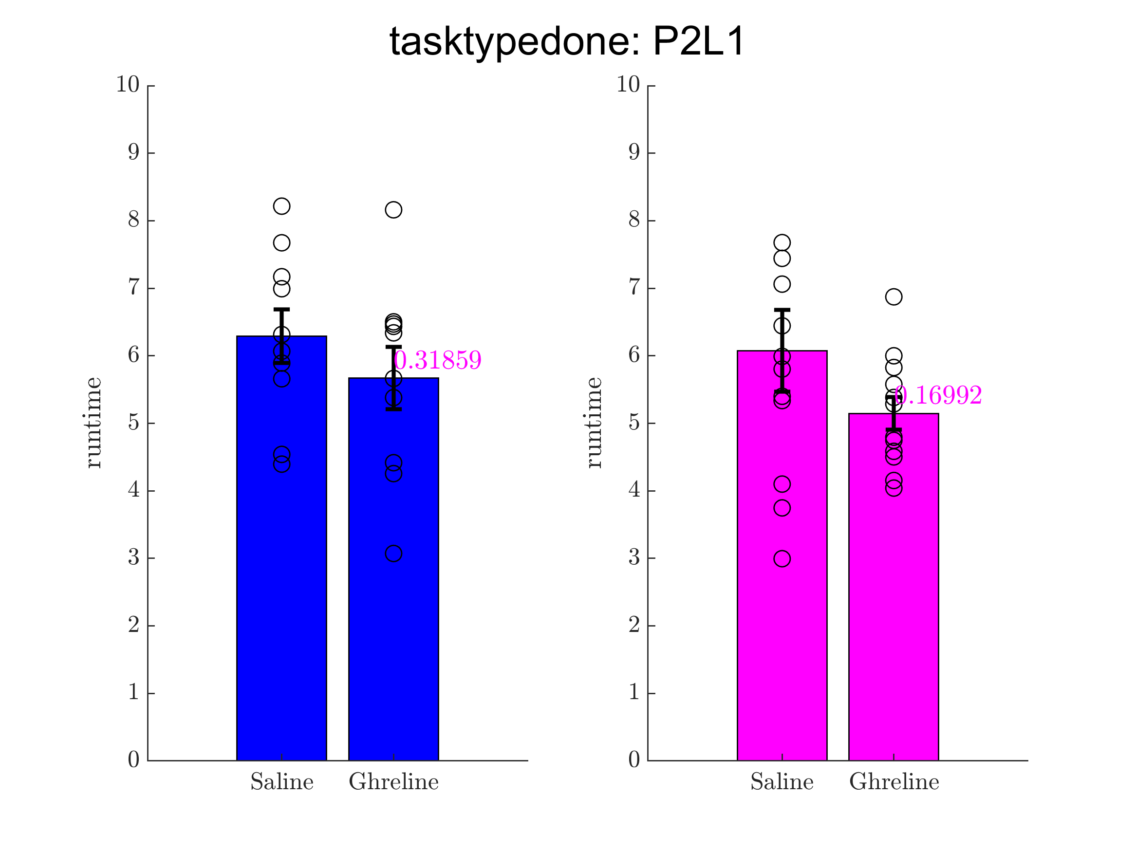
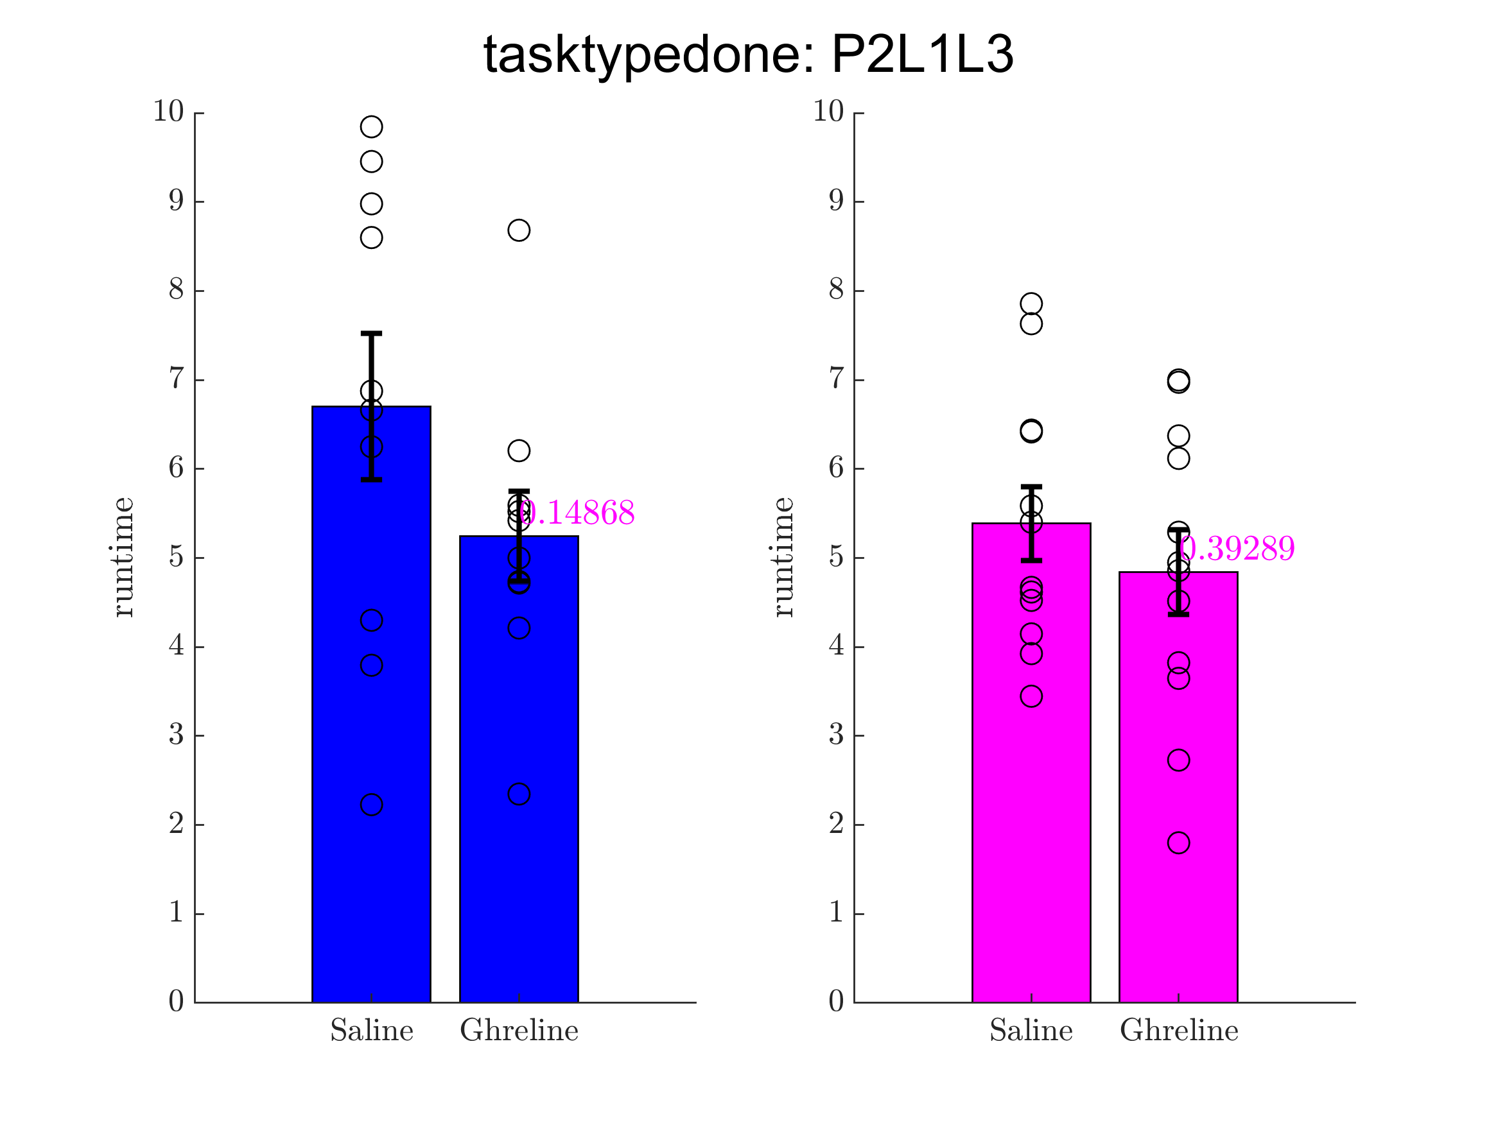
Runtime
Notes:
Refer featuresComparisonSalineVsGhrelinForMaleAndFemale

Slide 4
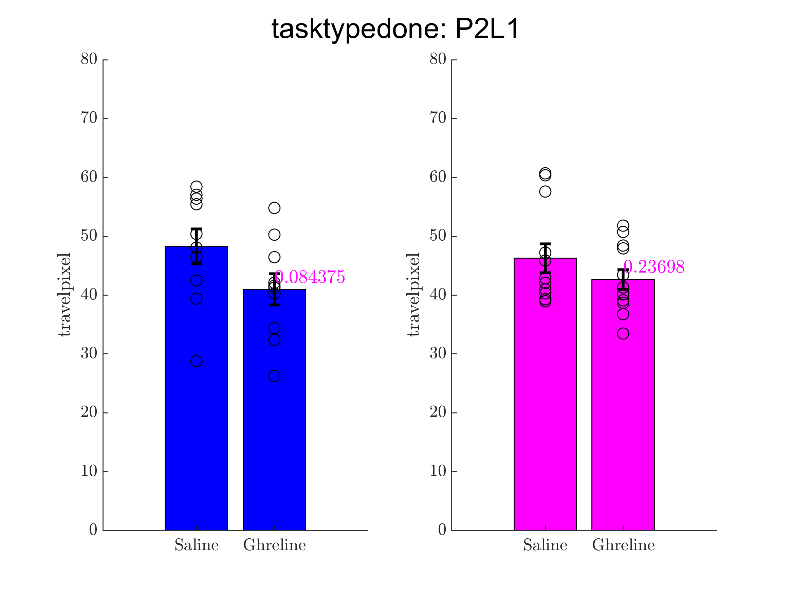
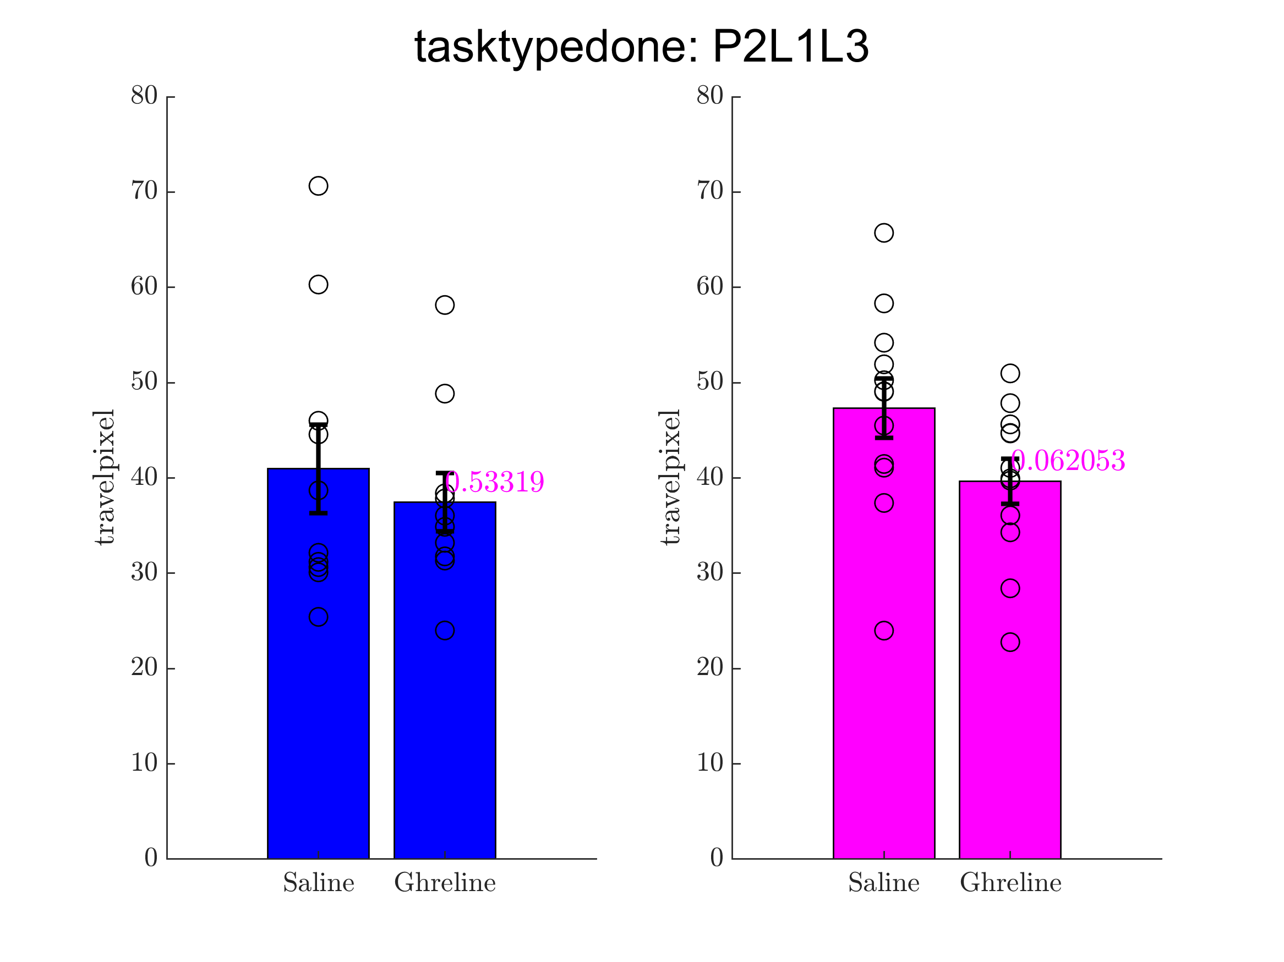
travelpixel
Notes:
Refer featuresComparisonSalineVsGhrelinForMaleAndFemale

Slide 5
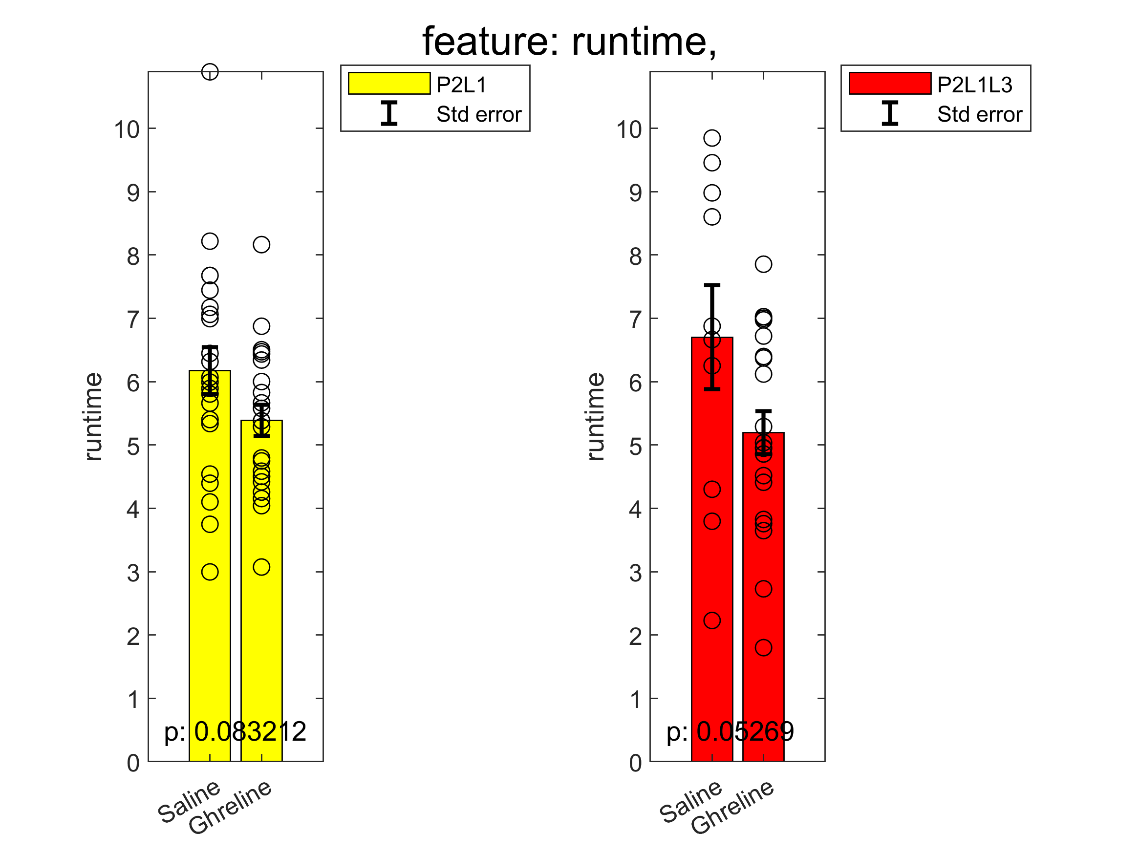
Feature comparison Saline vs Ghreline: runtime

Slide 6
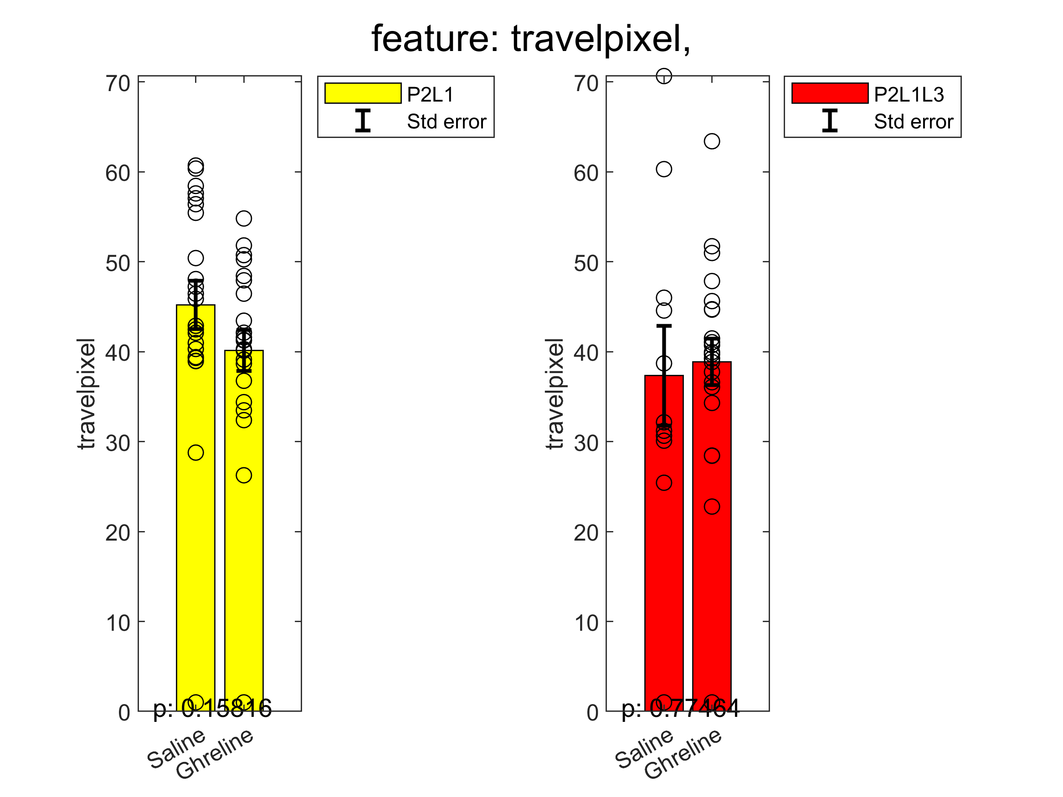
Feature comparison Saline vs Ghrelin: travelpixel

Slide 8
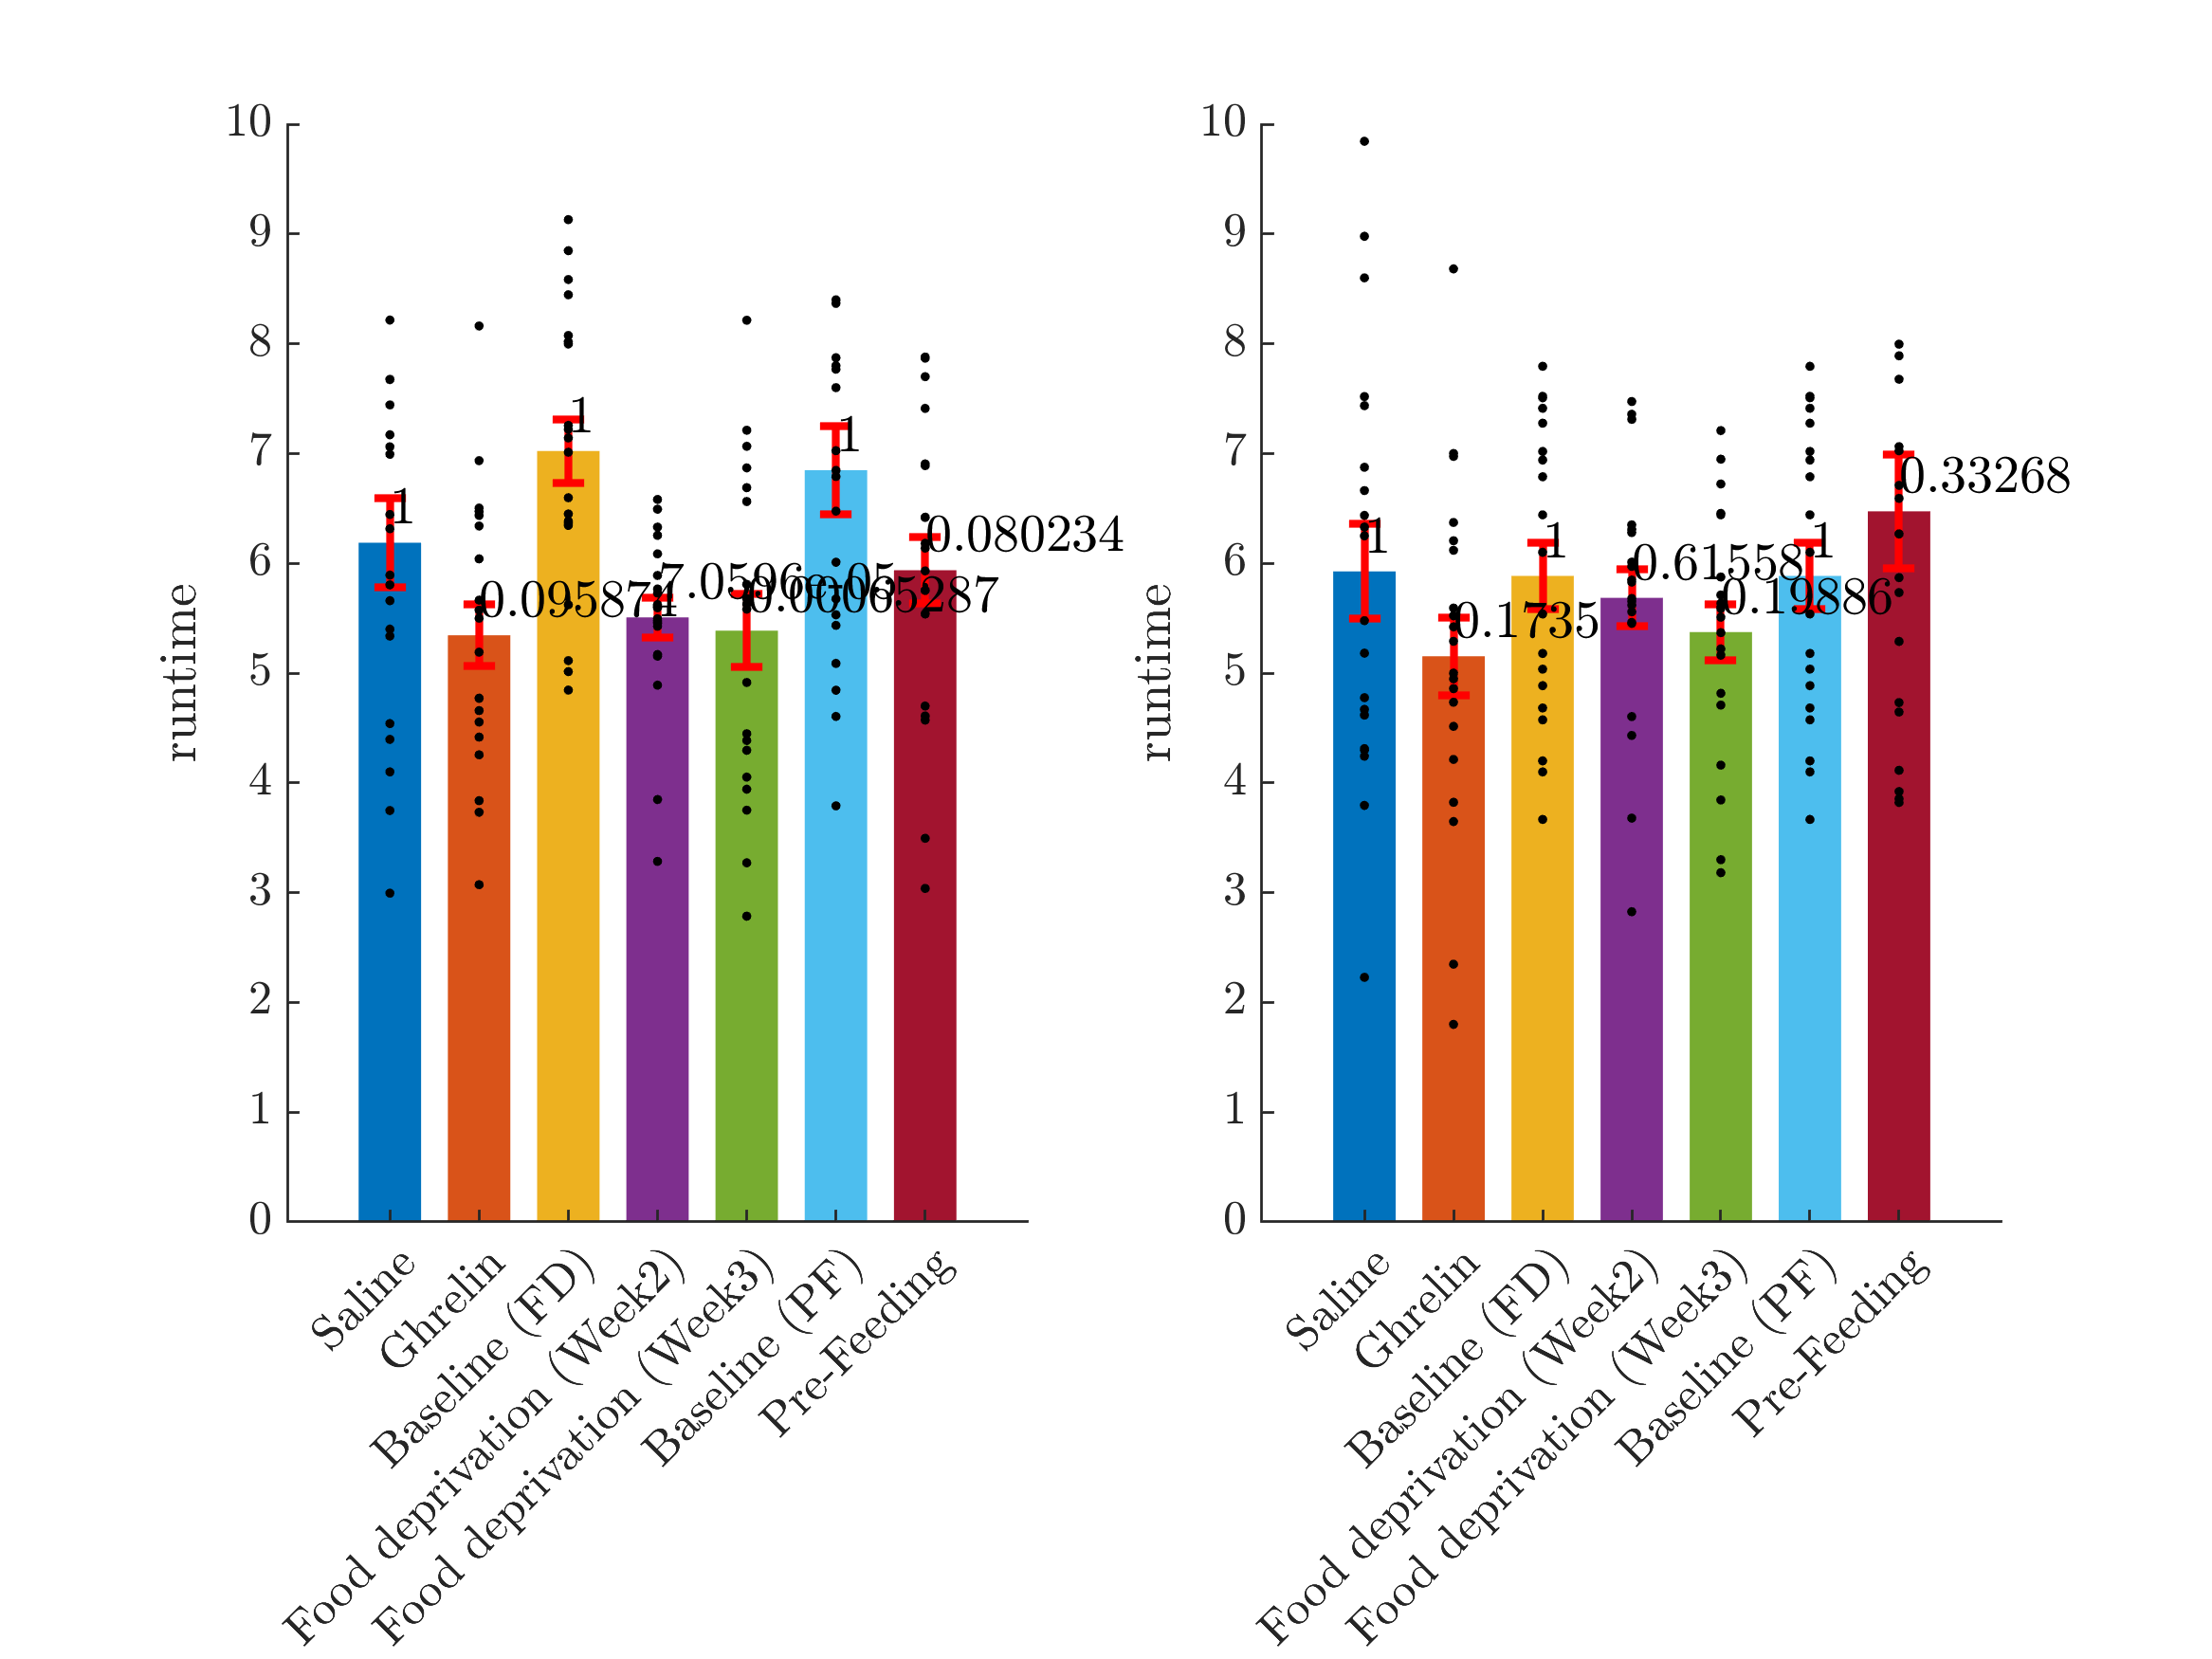
Notes:
Refer to featureComparisonAllExperiments

Slide 9
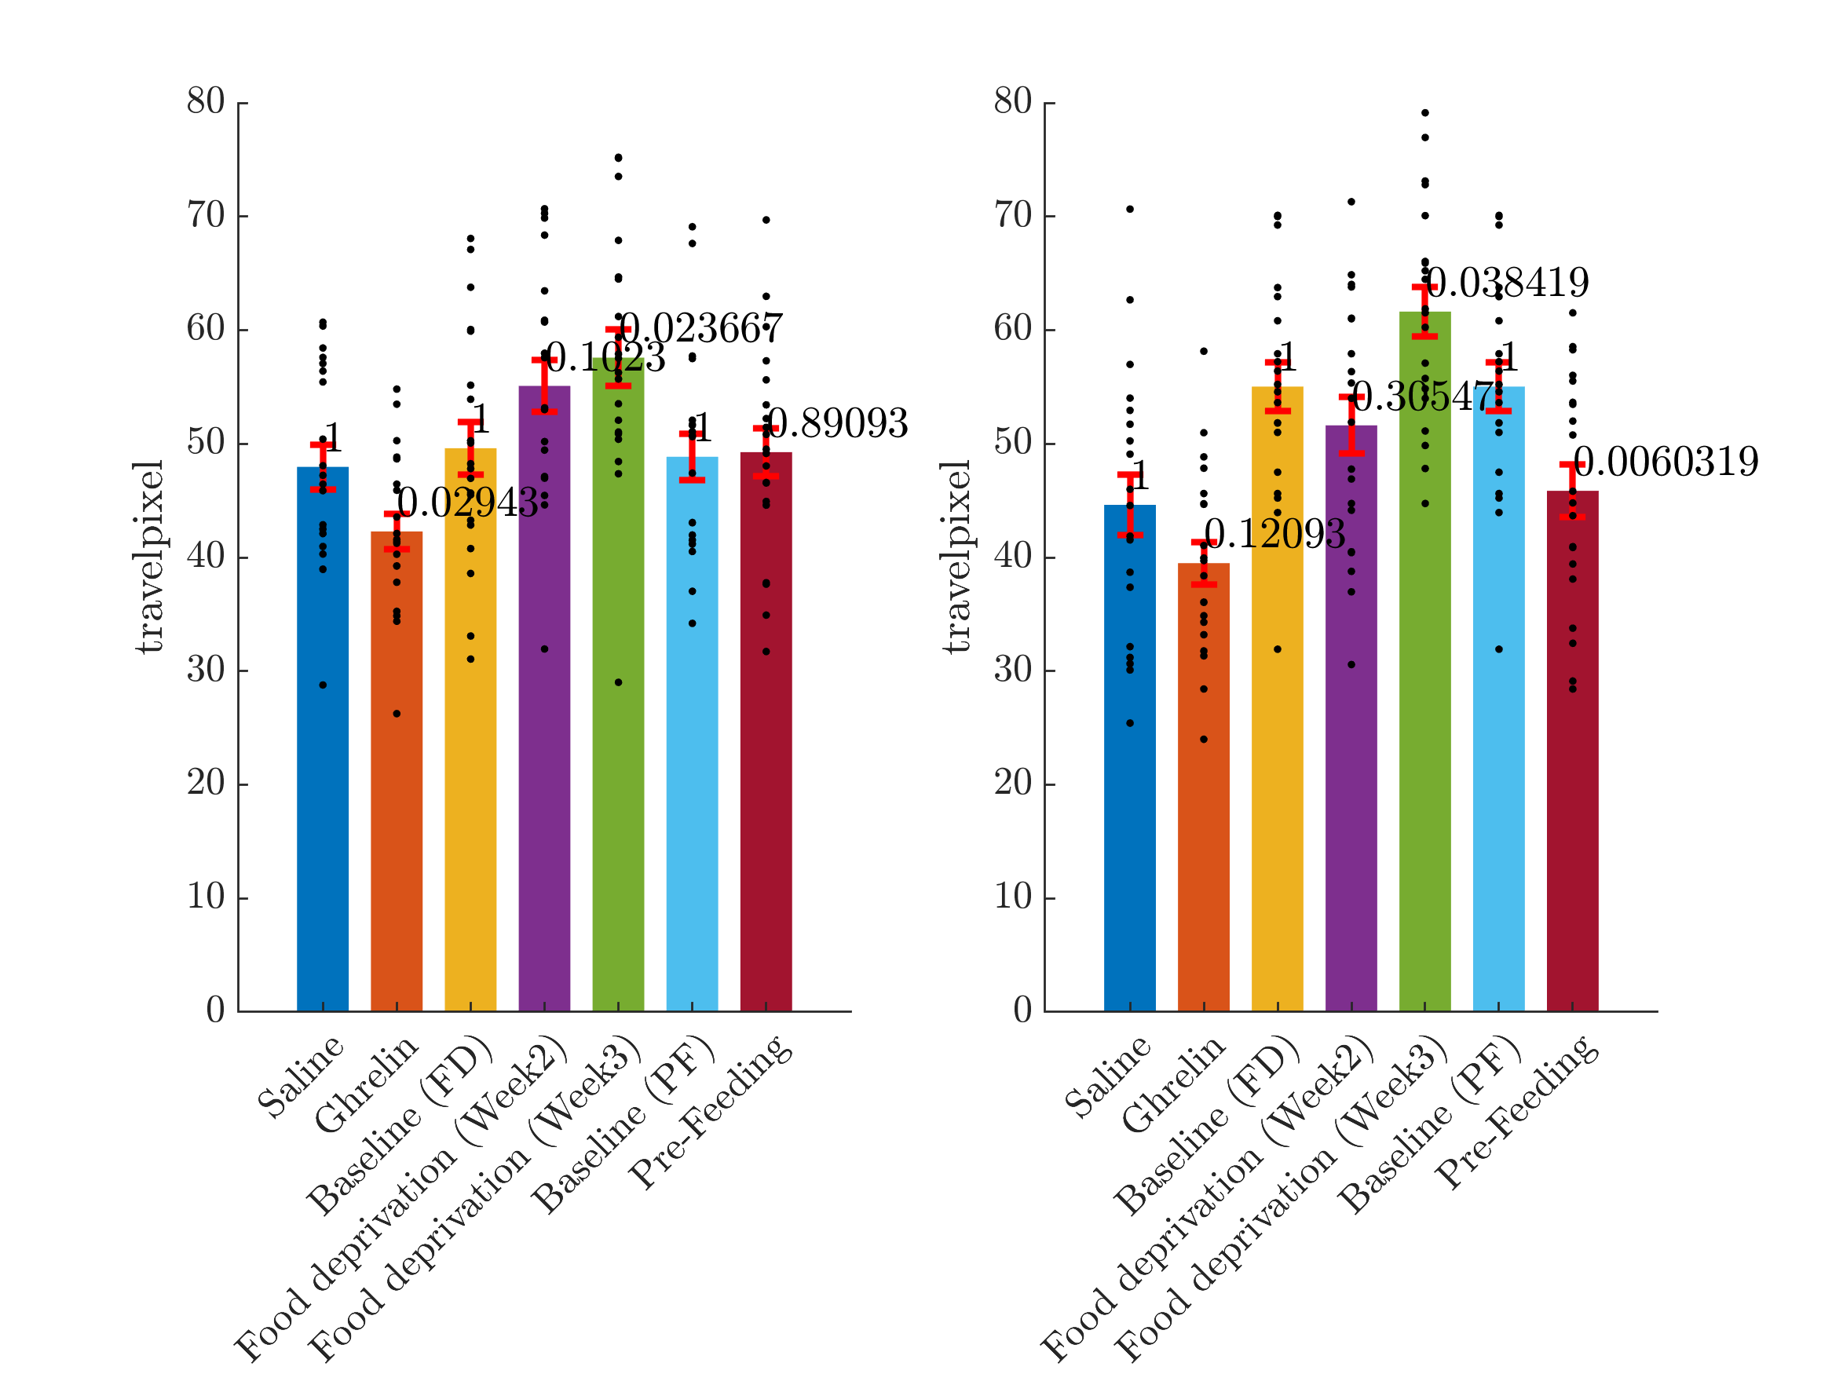
Notes:
Refer to featureComparisonAllExperiments

Slide 10
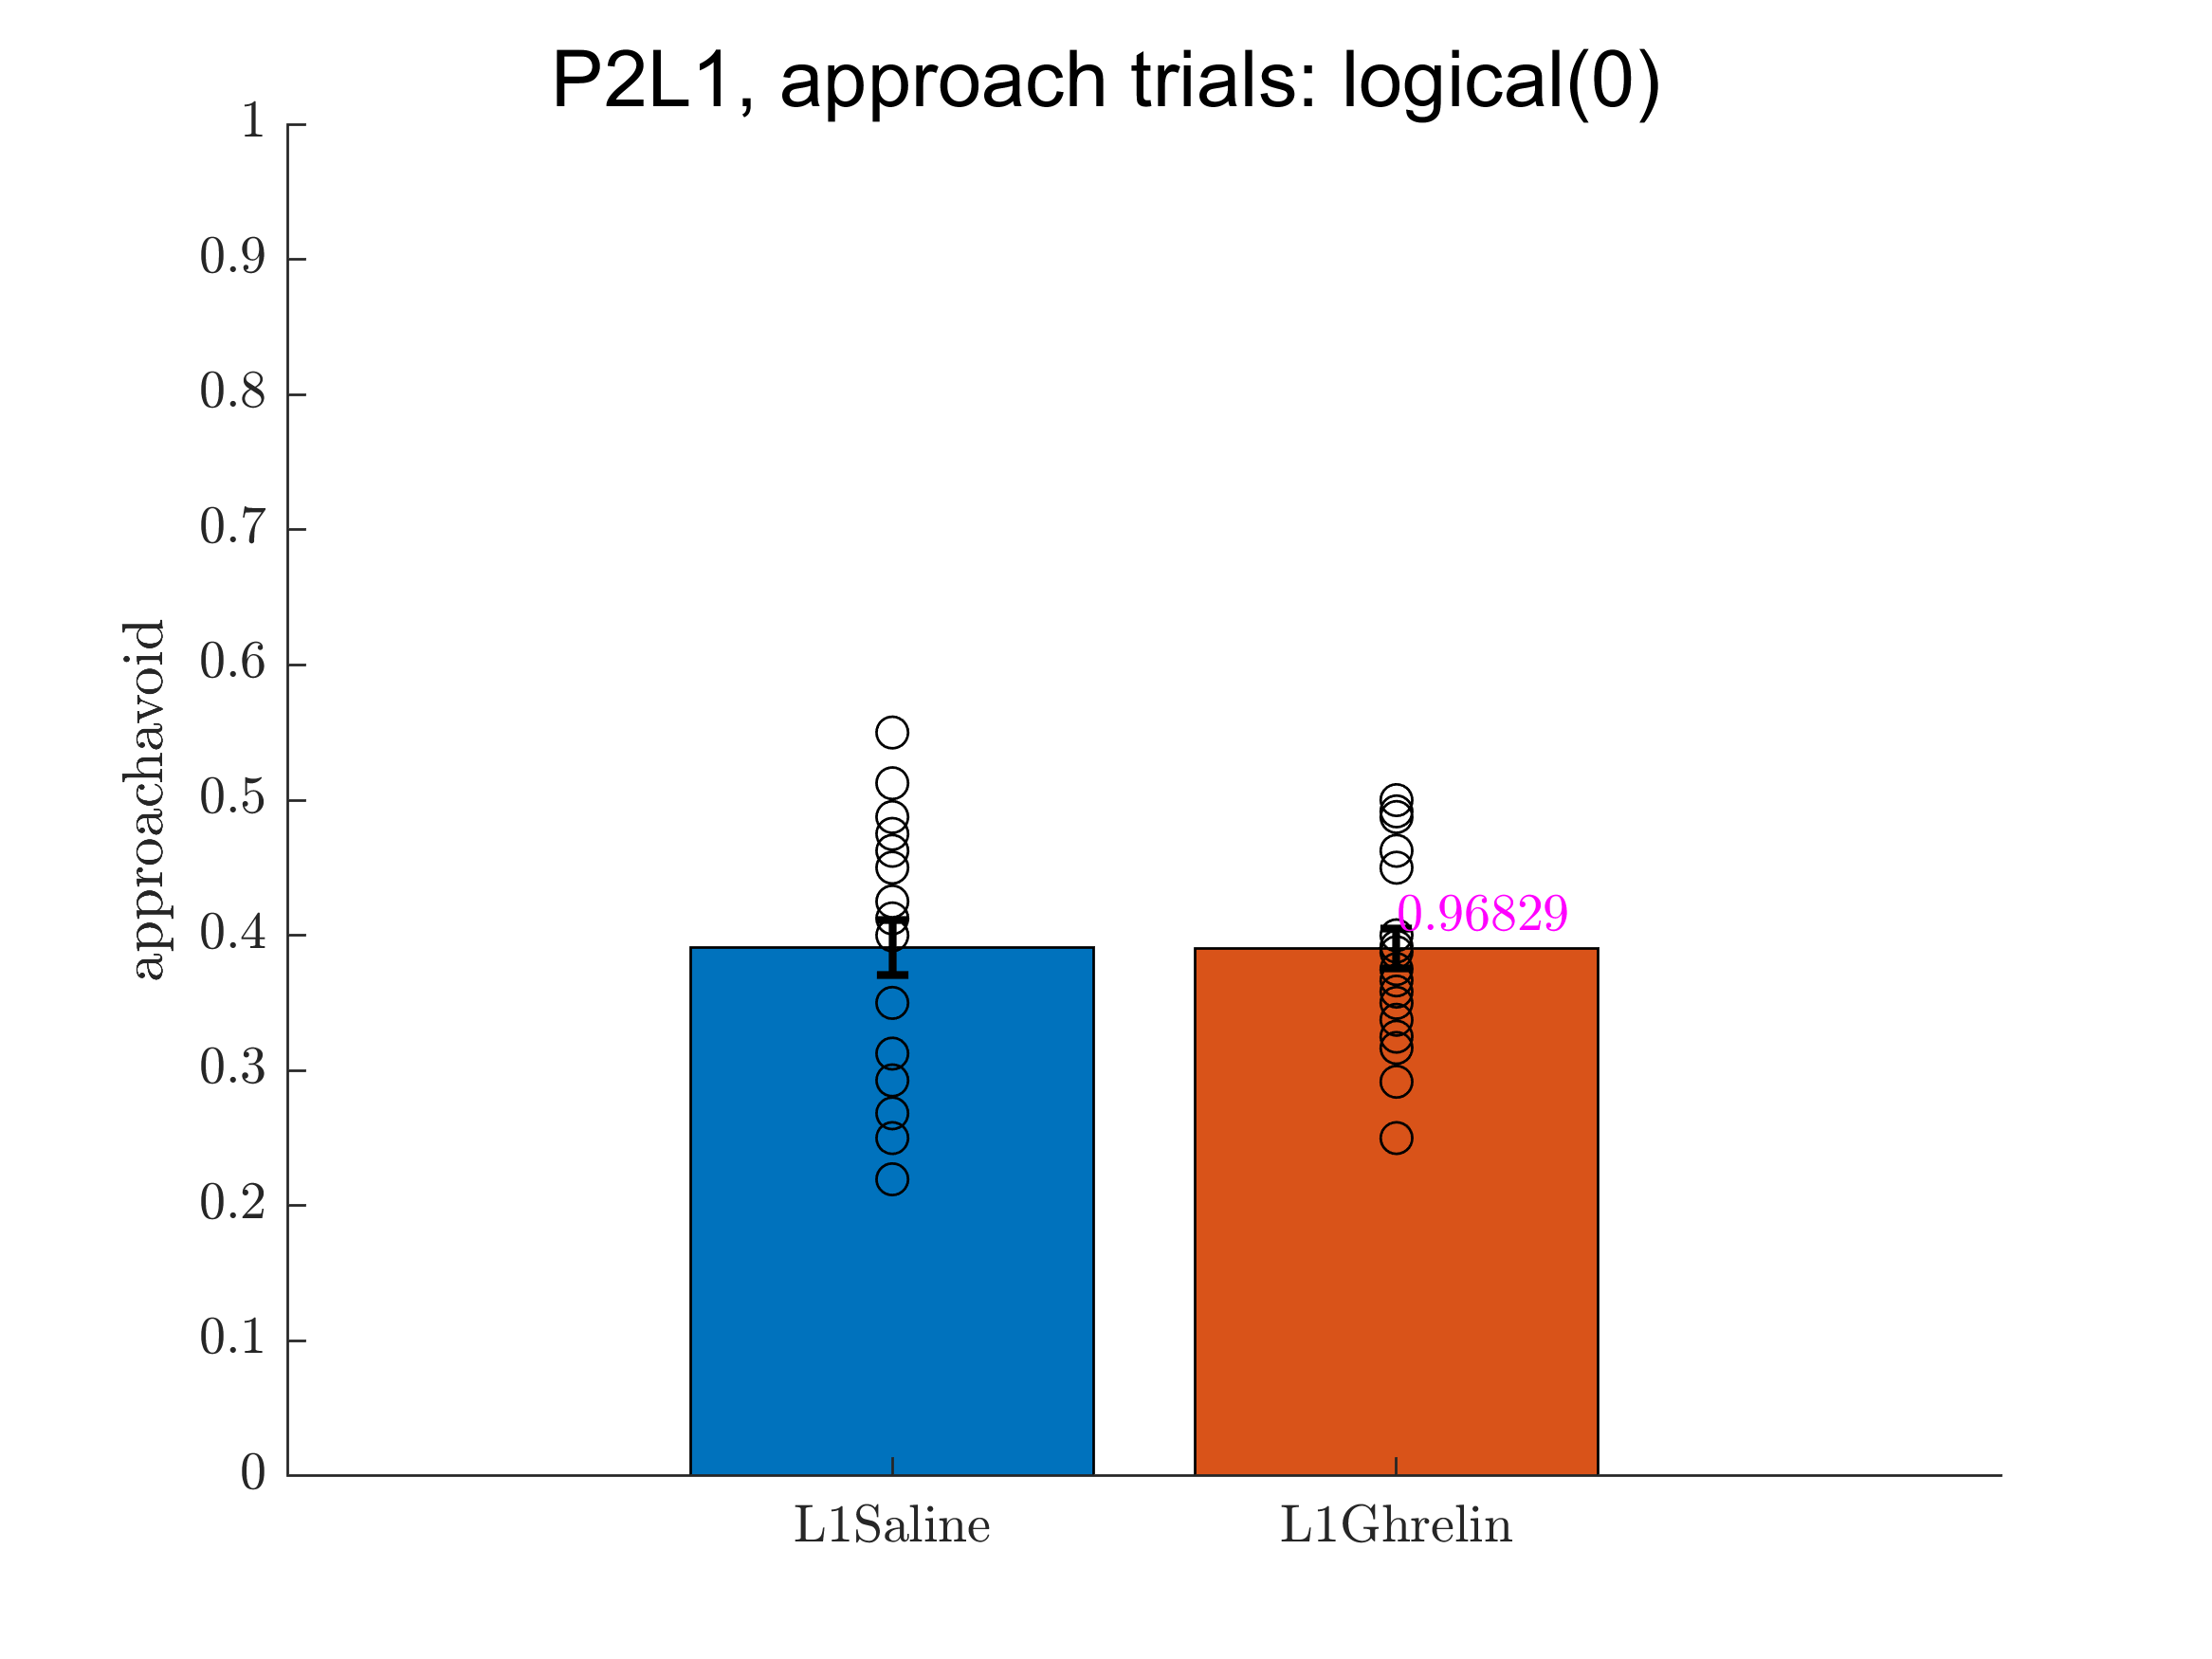
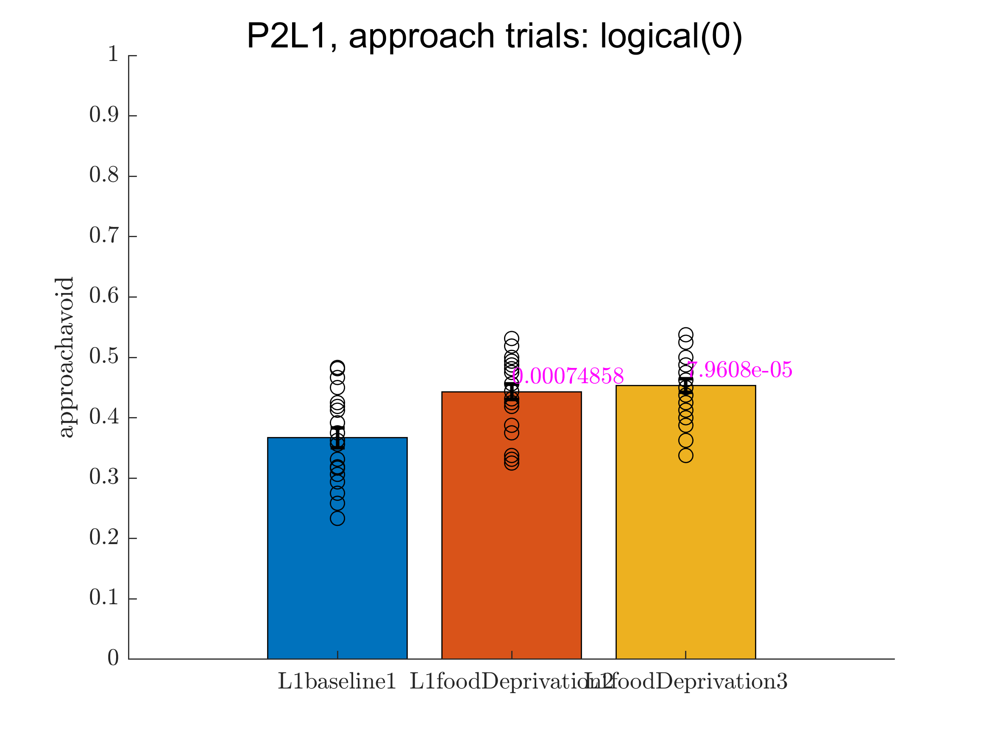
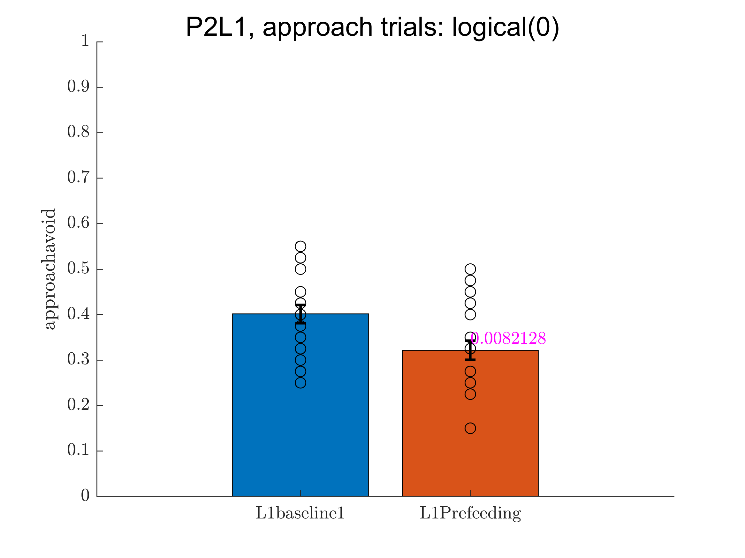
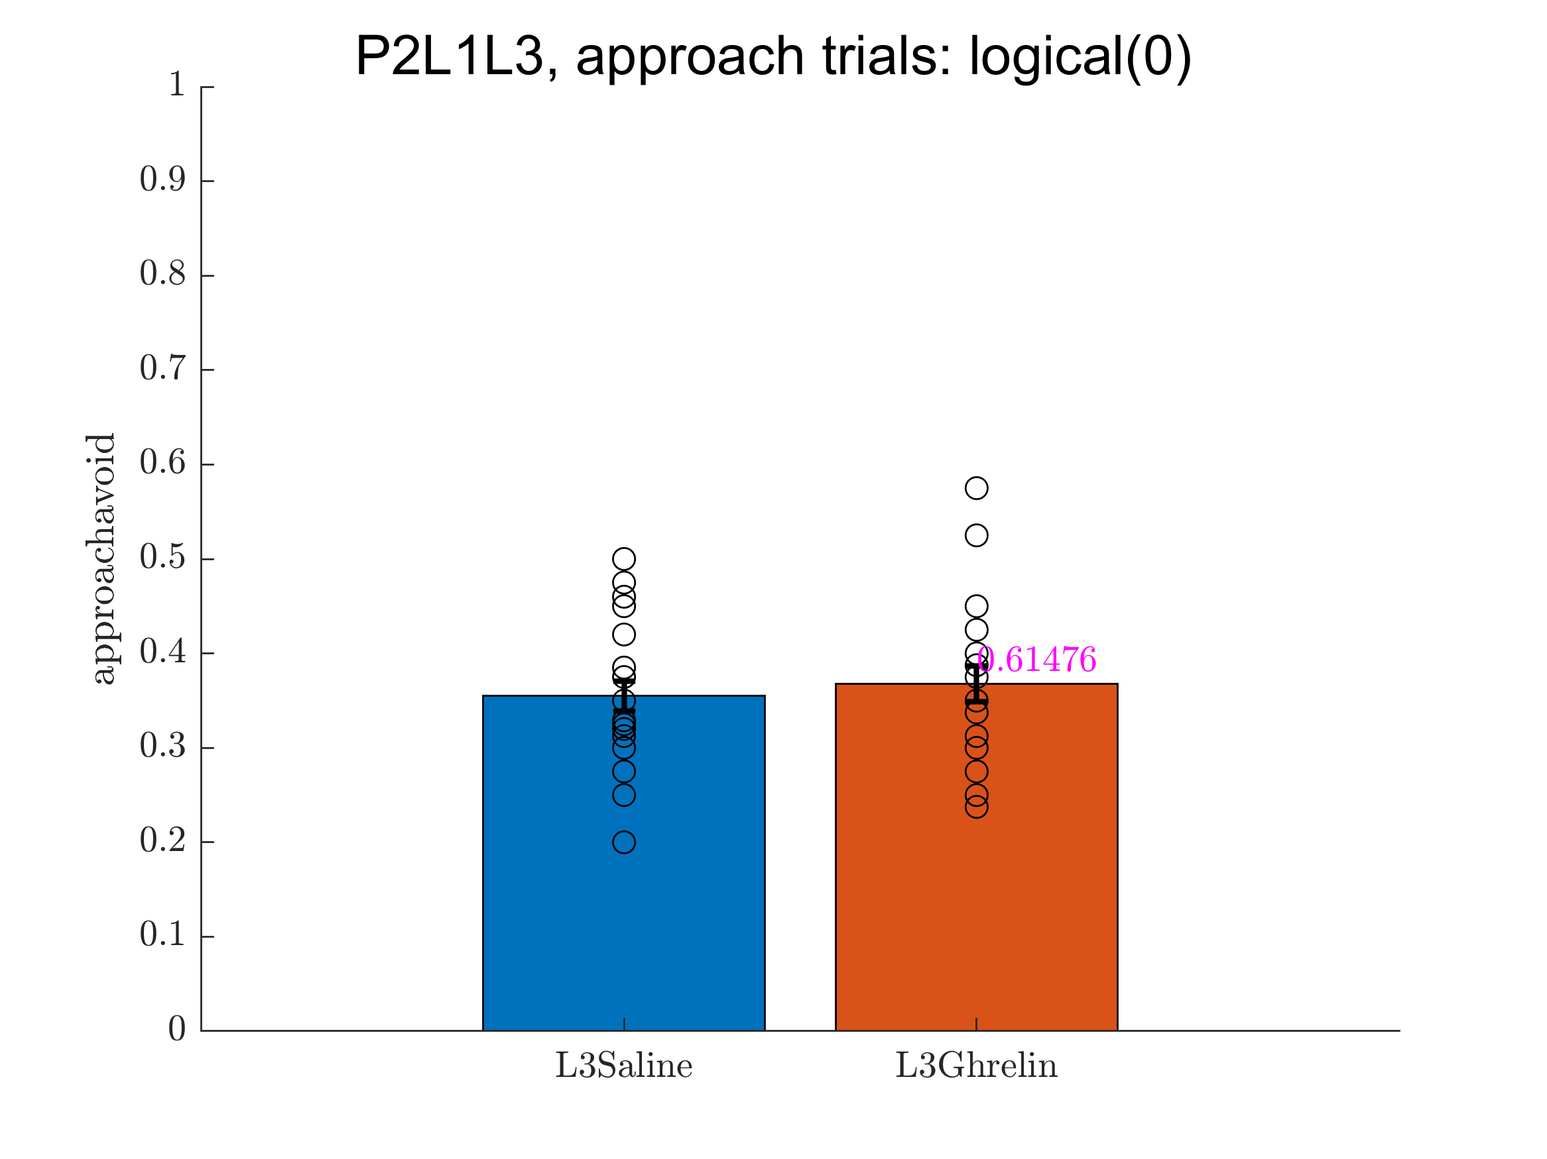
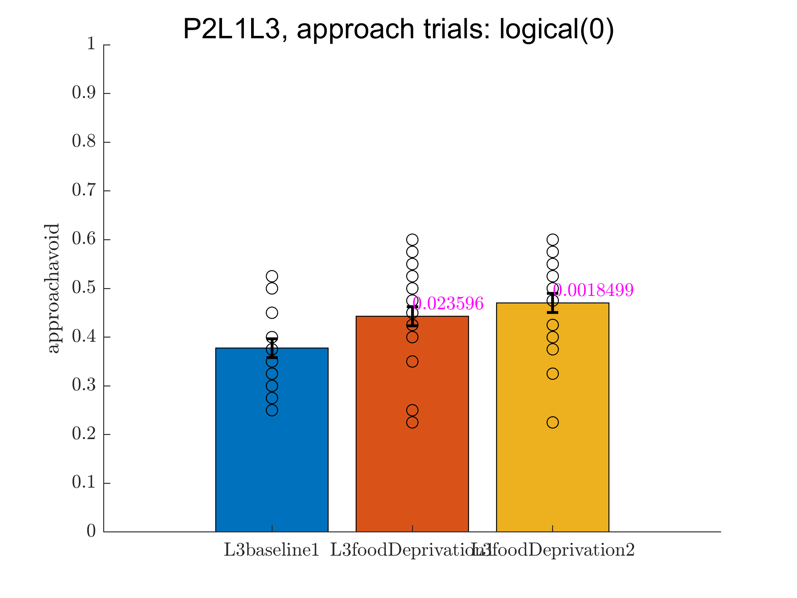
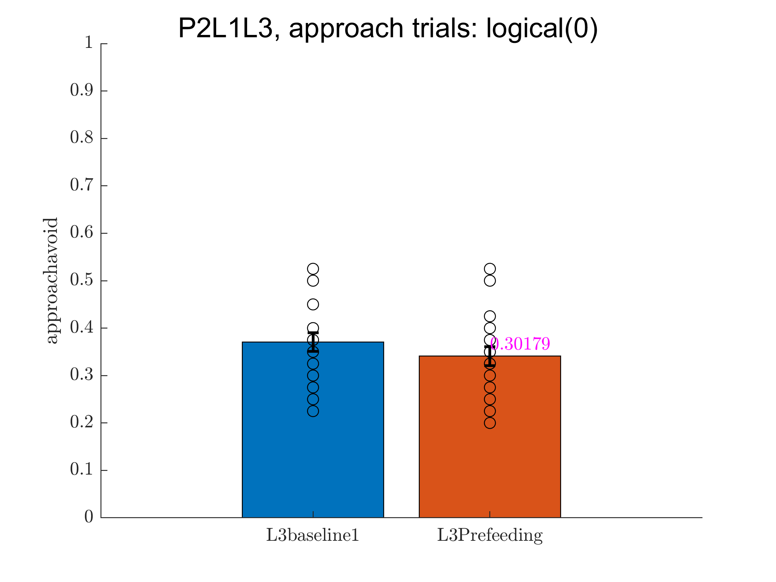

Slide 11
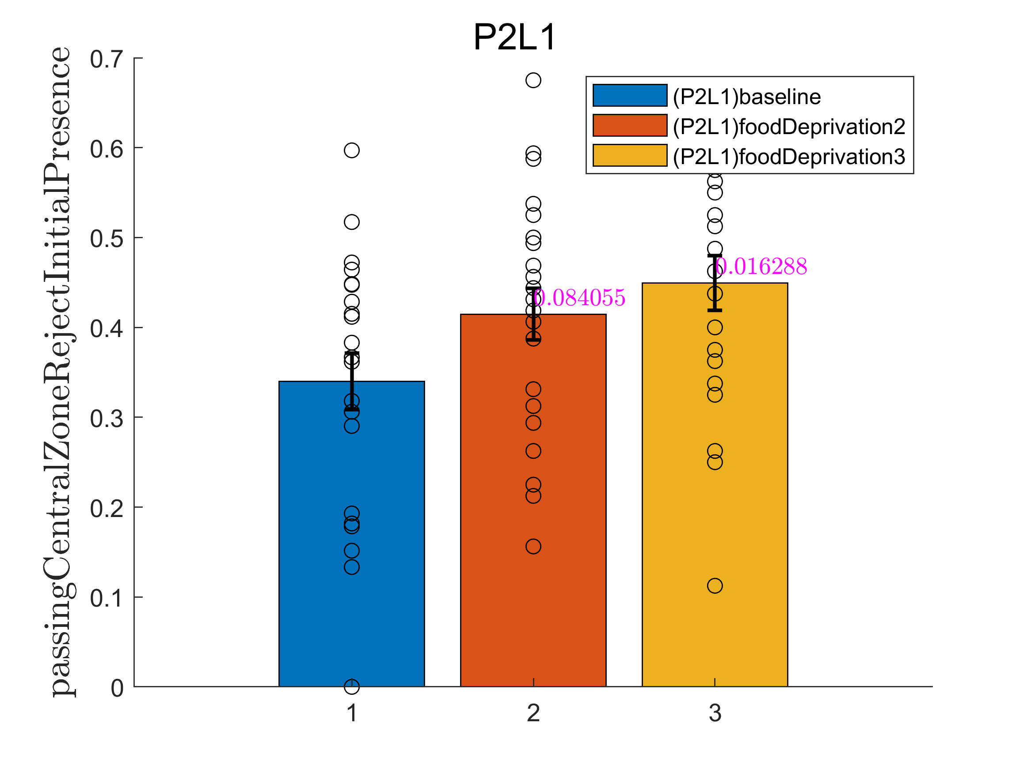
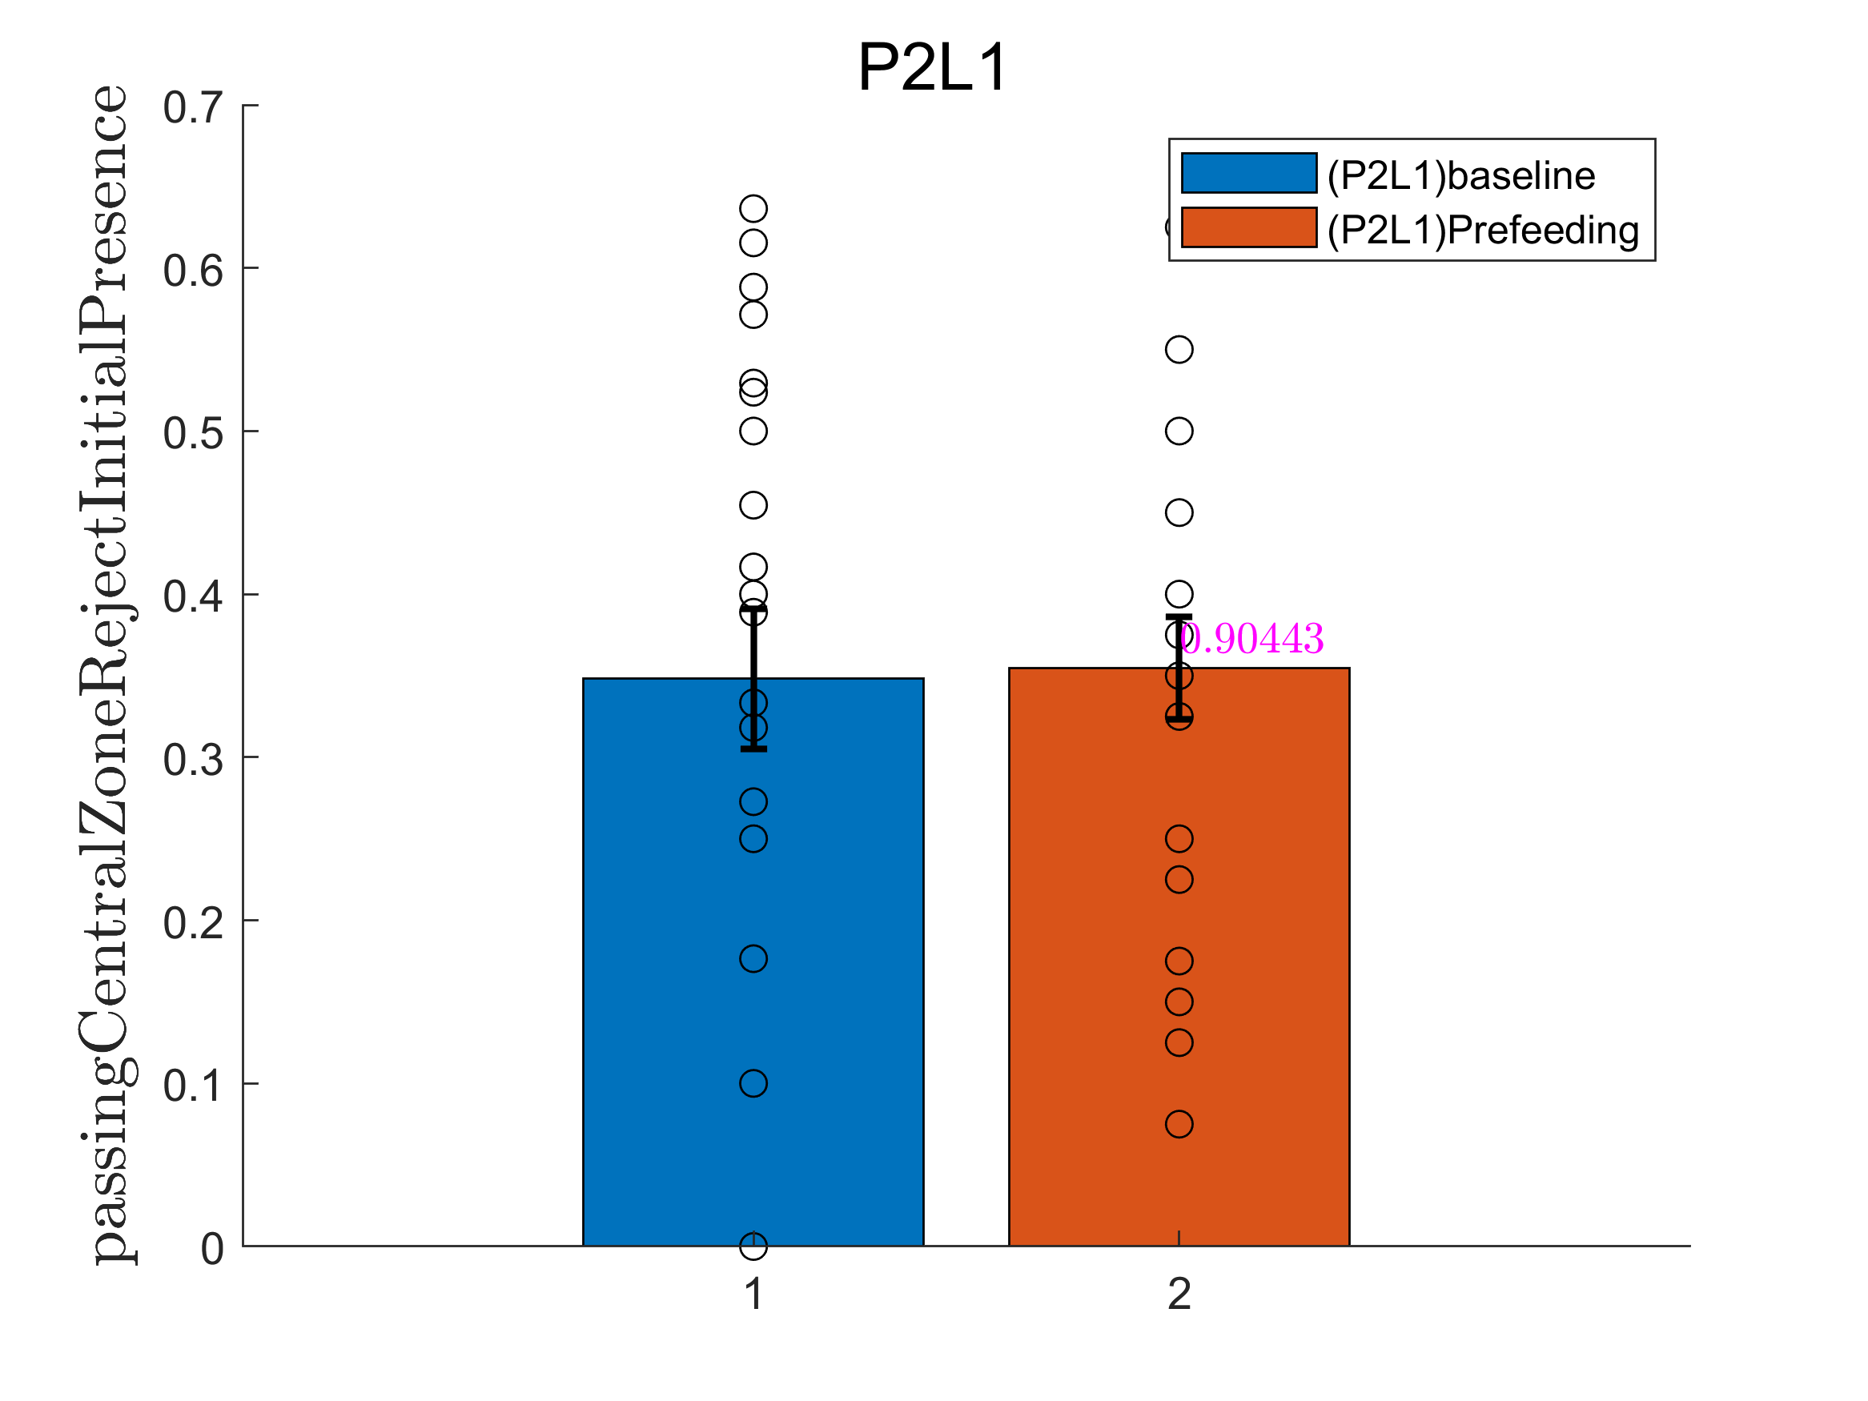
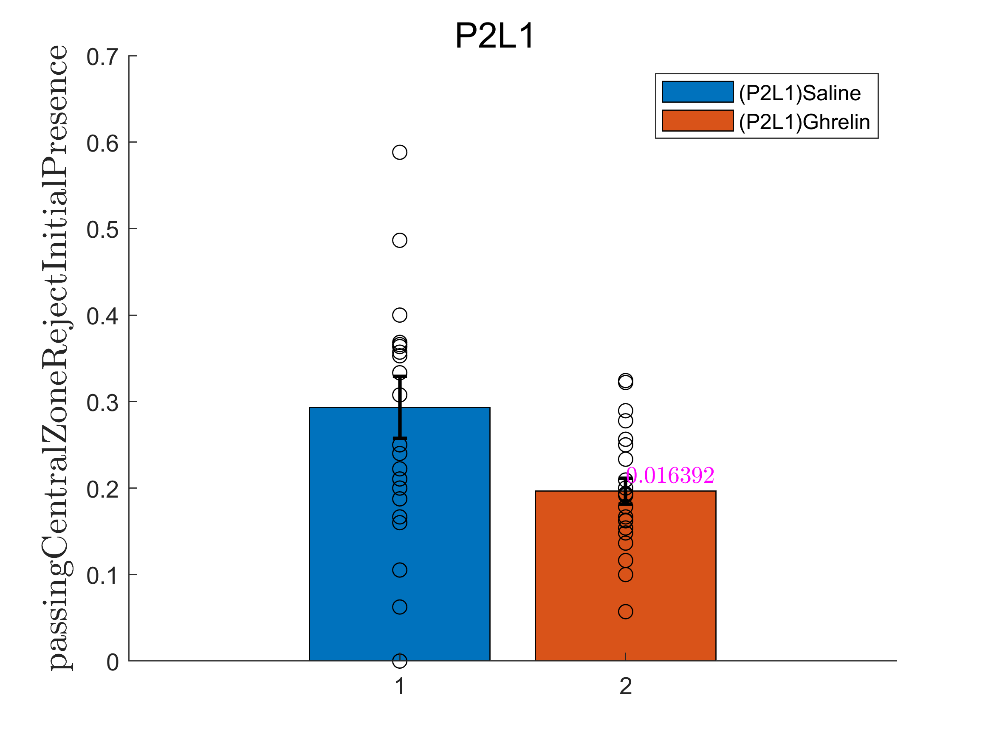
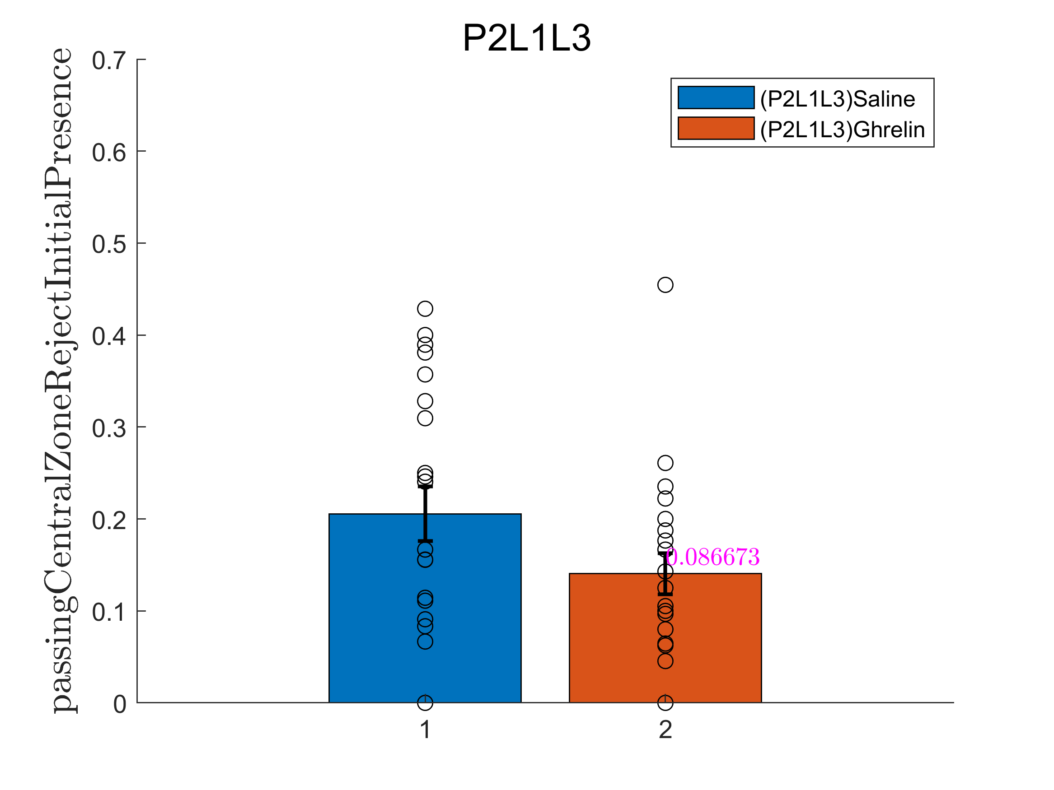
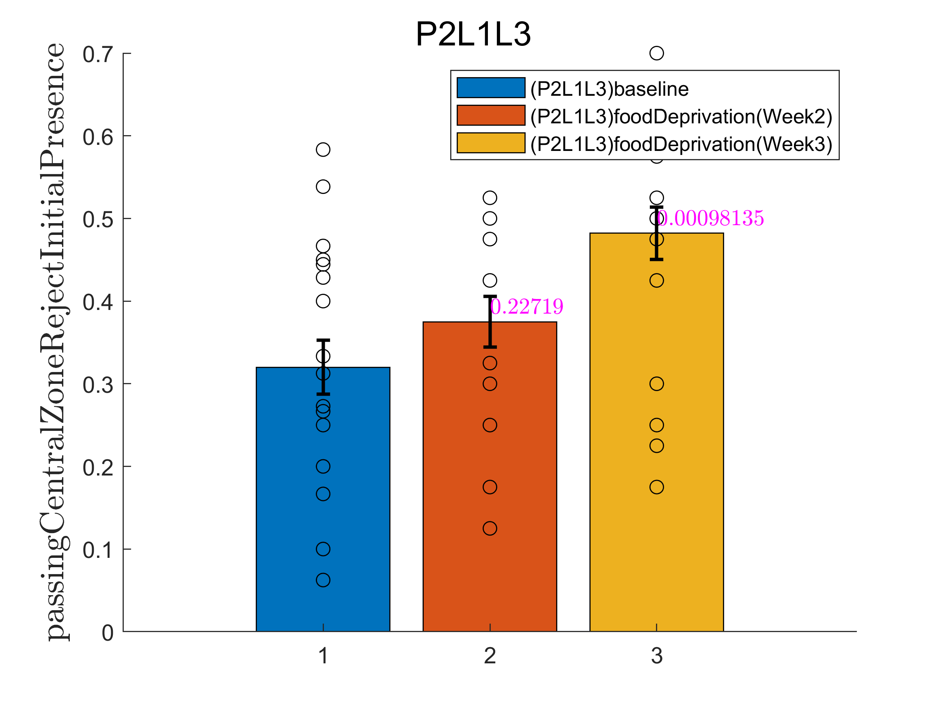
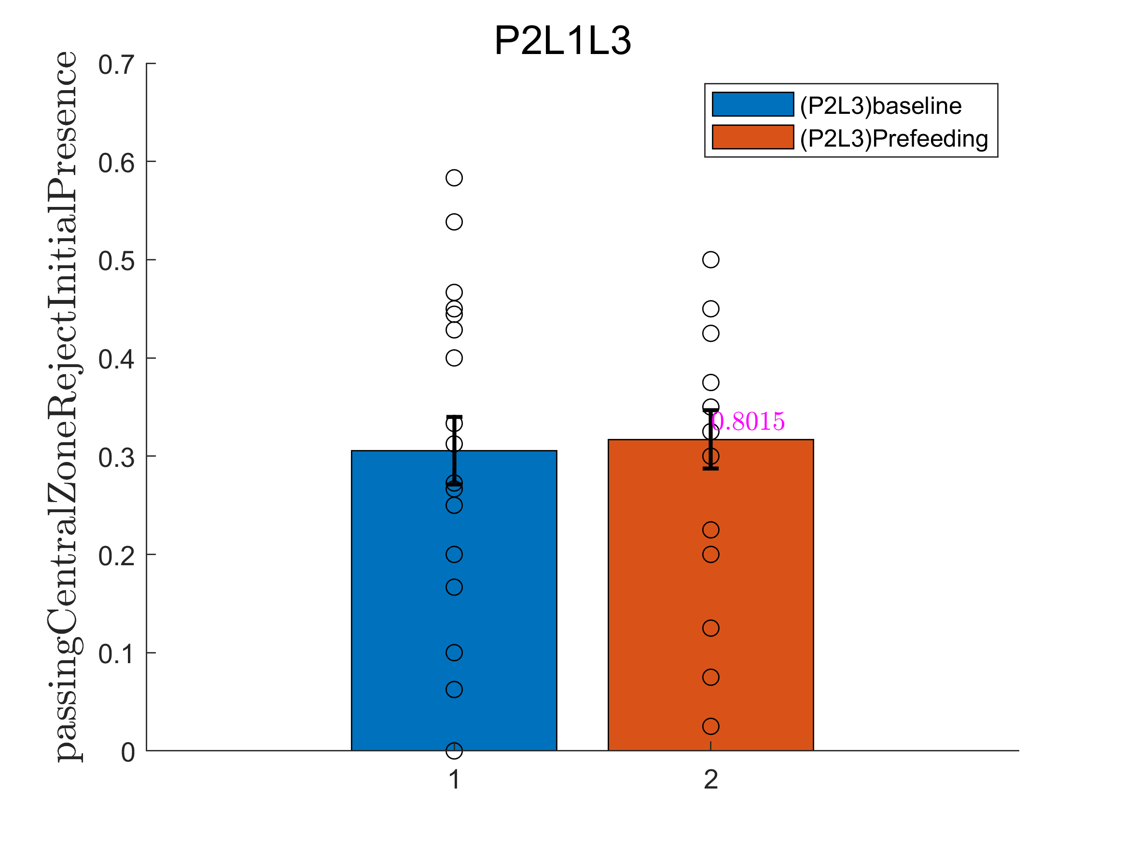
Control vs Manipulation: going through center

Slide 13
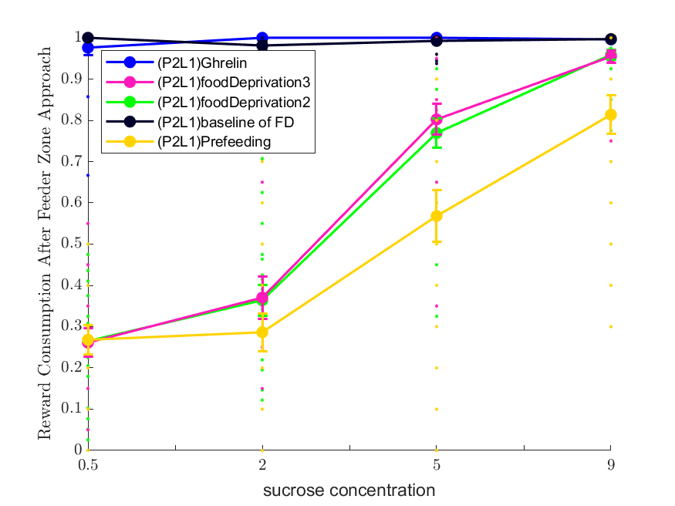
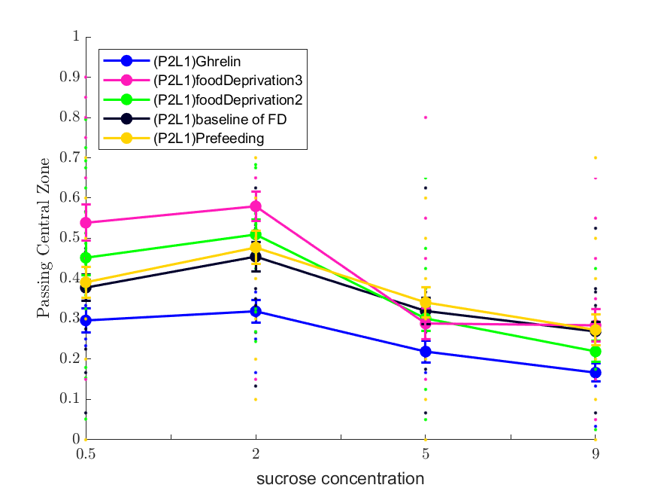
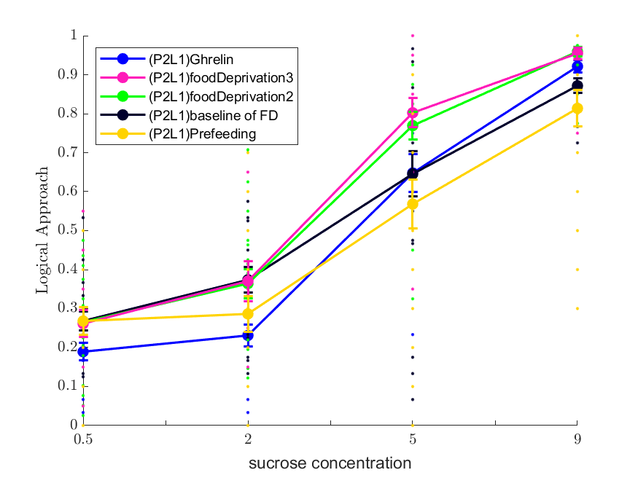
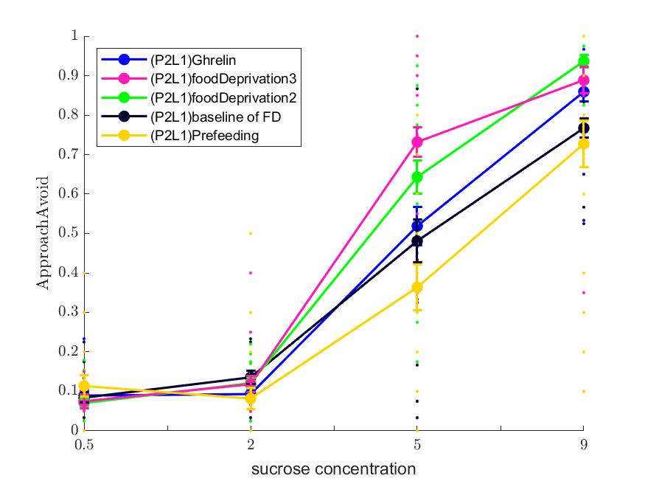

Slide 14
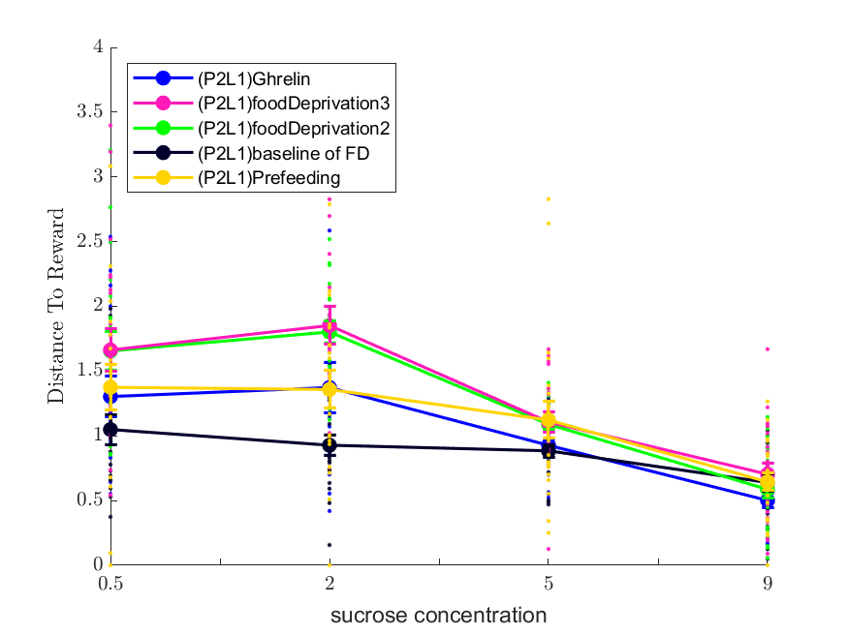
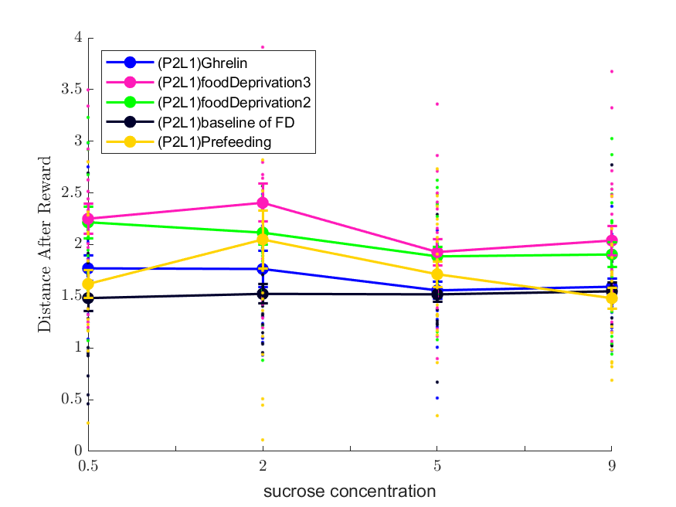
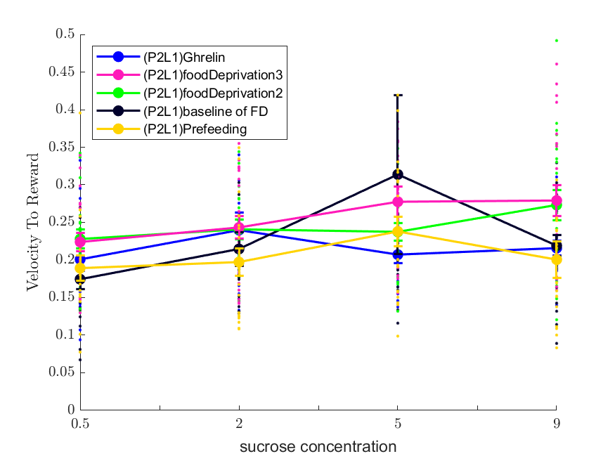
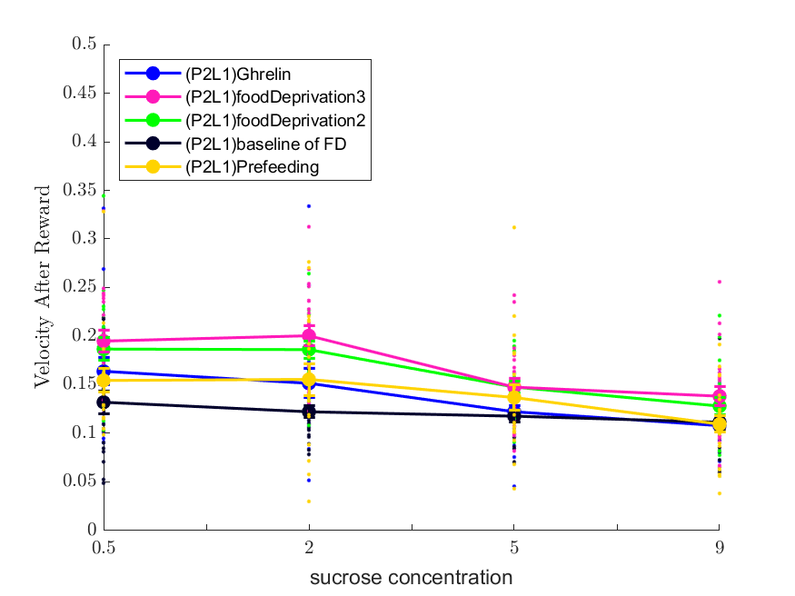

Slide 15
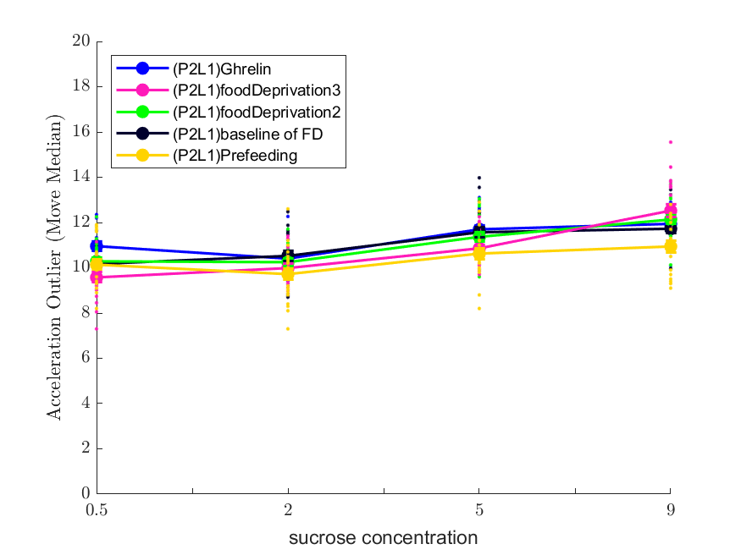
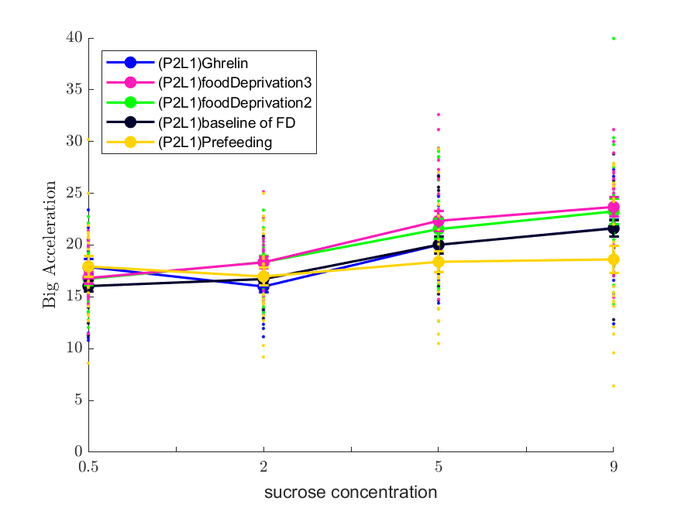
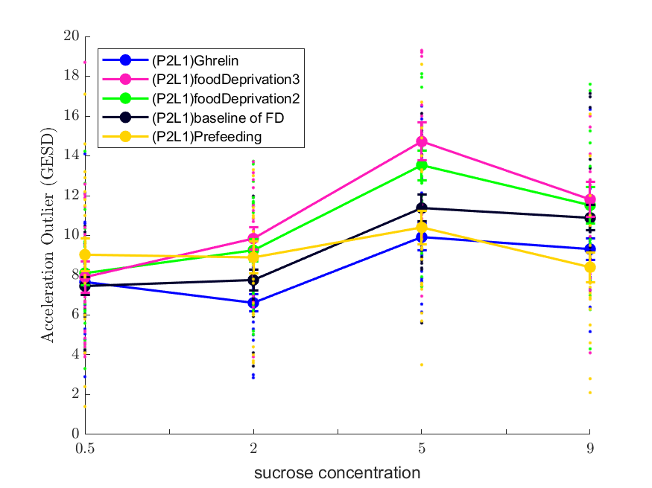
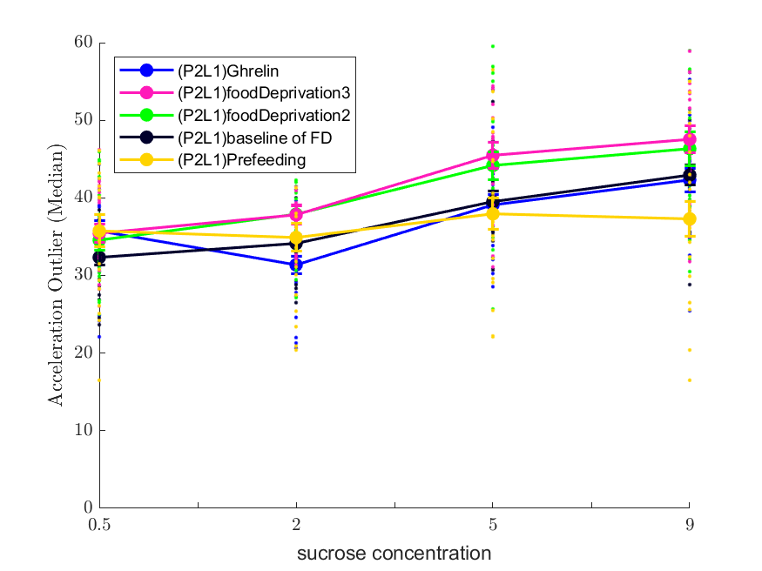
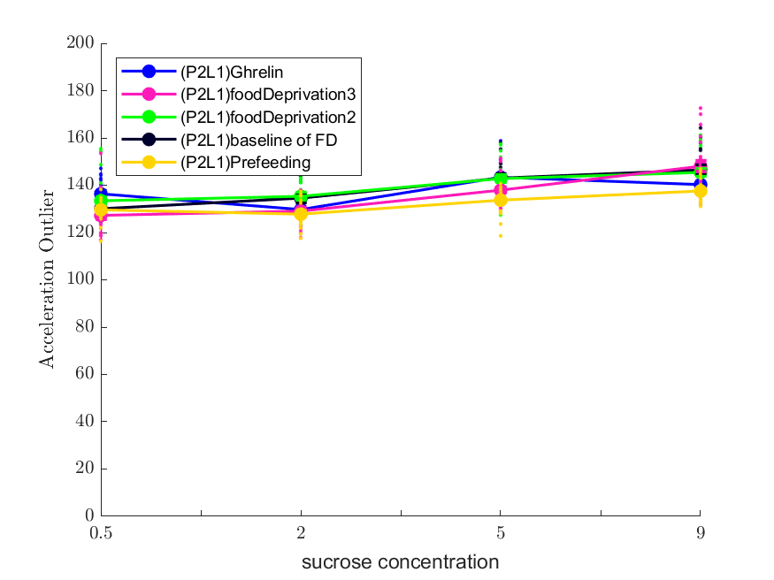
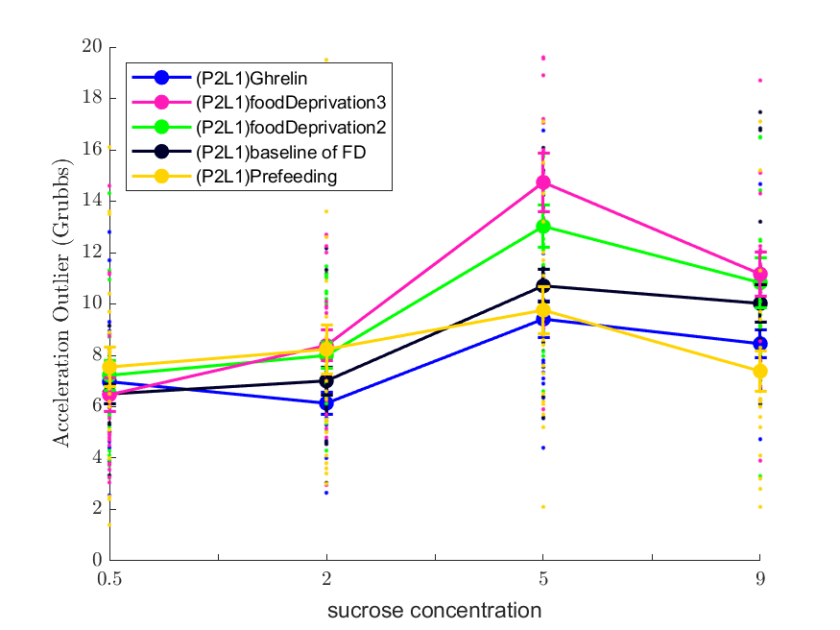
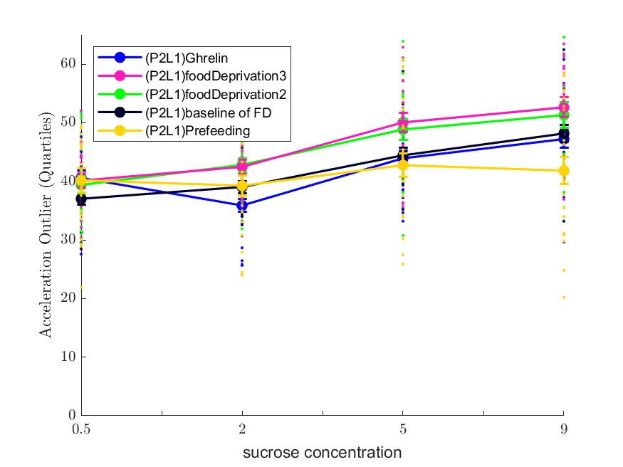
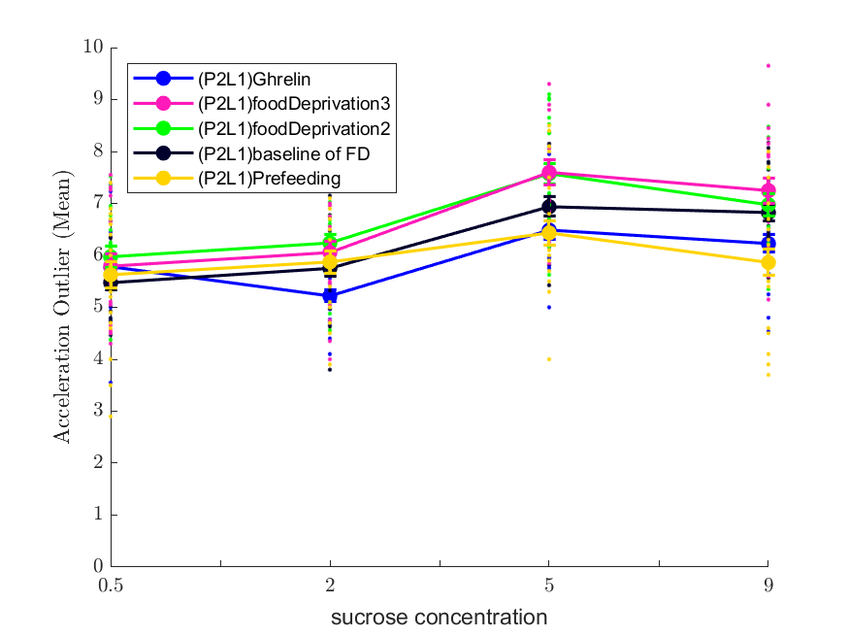
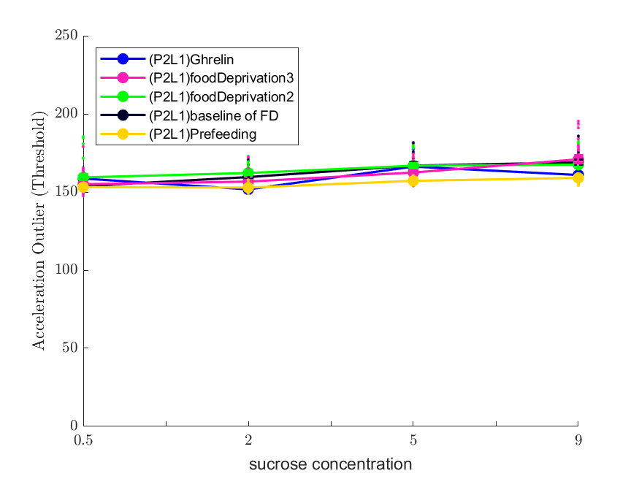

Slide 16
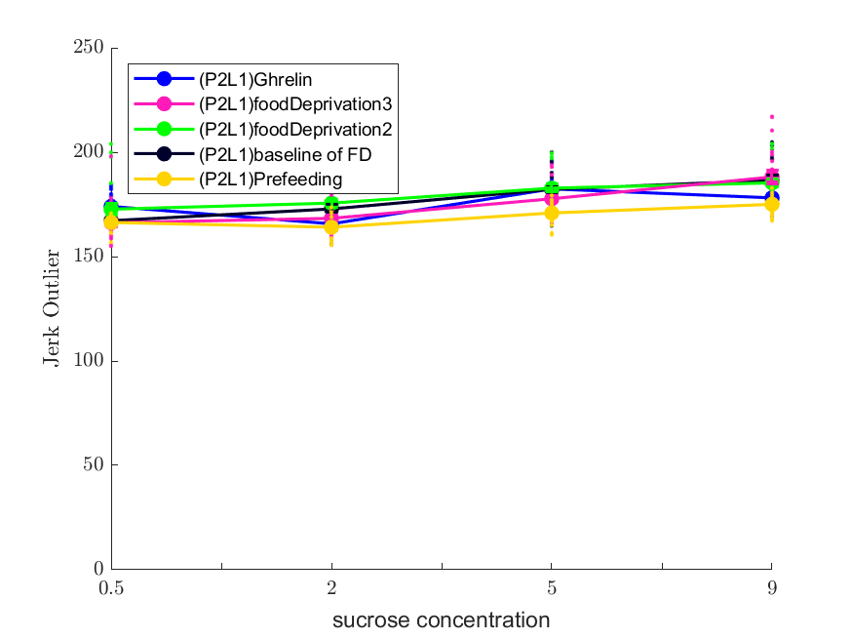
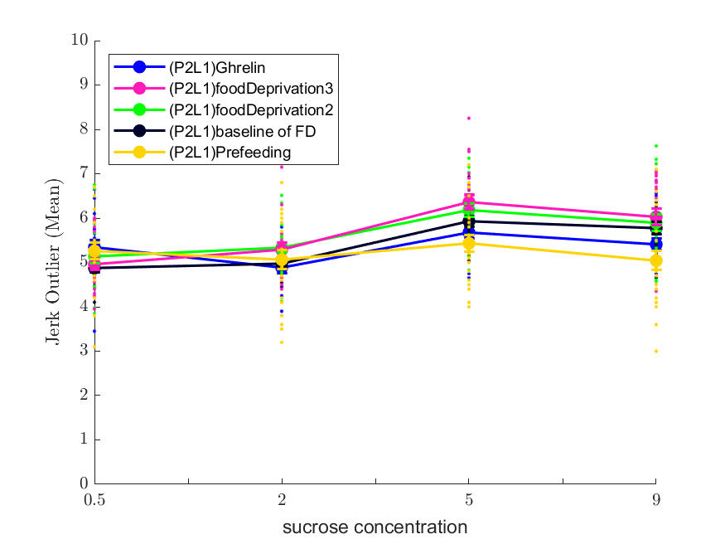
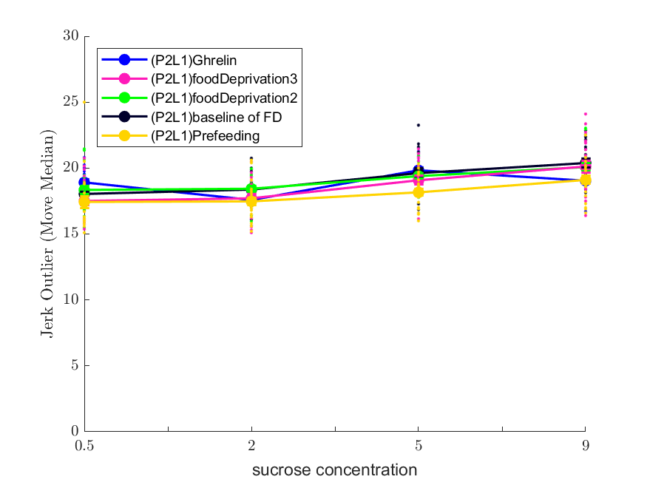
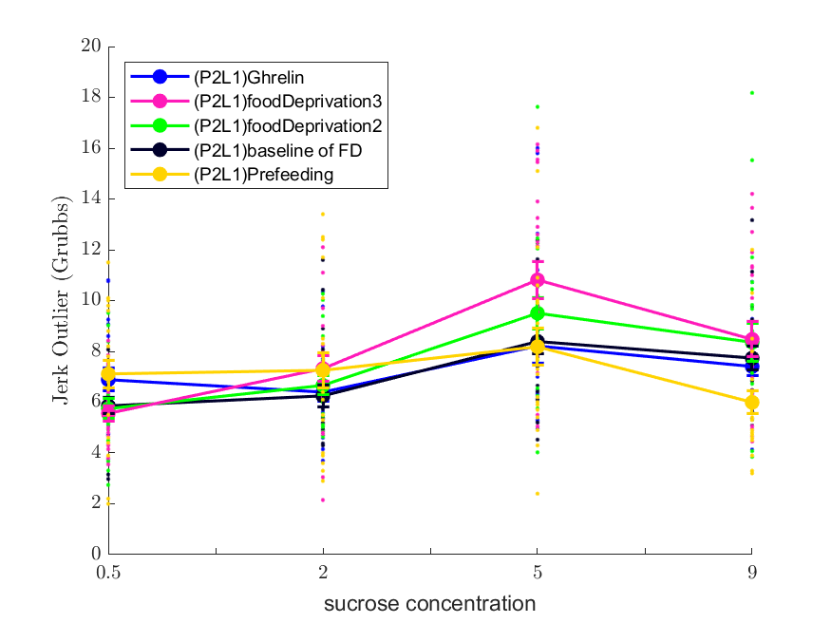
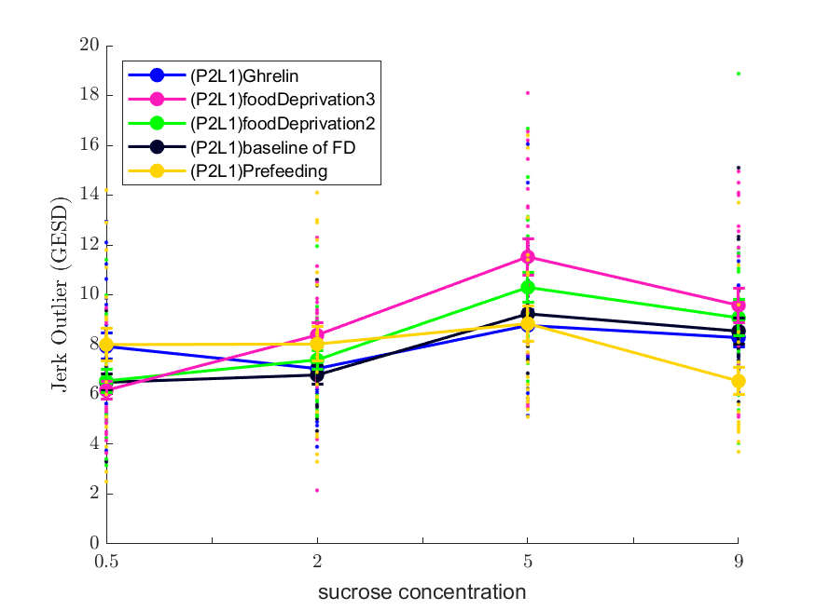





Slide 17





Slide 18



Slide 19







Slide 20







Slide 21





Slide 22



Slide 24






Baseline vs Food Deprivation: Feature demonstration
5a
5c
5d
5e
5f
5g

Slide 25





Food Deprivation: Sex Difference
S.6a
S6d
S6e
S.6b
S.6c

Slide 26




Slide 27


Baseline Vs Food Deprivation

Slide 28


Slide 29




Slide 30




Slide 31




Slide 32





Slide 33




Notes:
Saline Ghrelin

Slide 34



Notes:
Food Deprivation

Slide 35


Notes:
Pre-Feeding

Slide 36








Notes:
134891: FD L1, 137351: FD L1

Slide 37








Notes:
121633: Pre-FeedingL1, 121518: Pre-FeedingL1

Slide 38







Saline-Ghrelin/FD: (P2L1L3) approach trials; PF: (P2L1) all trials

Slide 39





Slide 40



Slide 41


Slide 42











Slide 43











Slide 44











Slide 45











Slide 46











Slide 47











Slide 48











Slide 49











Slide 50











Slide 51











Slide 52











Slide 53











Slide 54











Slide 55




Slide 56





Slide 57





Slide 58





Slide 59





Slide 60





Slide 61





Slide 62





Slide 63





Slide 64





Slide 65





Slide 66





Slide 67





Slide 68





Slide 70







Slide 71







Slide 72







Slide 73







Slide 74







Slide 75







Slide 76







Slide 77







Slide 78







Slide 80





Baseline: passing through center

Slide 81





Food Deprivation: passing through center

Slide 82



Slide 83


Notes:
Id: 92597, 135600

Slide 84


Notes:
Id: 88385, 91303

Slide 85


Notes:
Id: 200894, 206523

Slide 86


Notes:
Id: 91864, 137421

Slide 88
Pepper: No Oxy Data
No entry of Oxy Data
05/24/2022 - 09/13/20222
Oxy: 04/26 - 05/09

Slide 89








Pepper: Incubation (Good Sigmoid: 0.5000)

Slide 90
Captain: No Oxy Data
No entry of Oxy Data
05/25/2022 - 09/13/20222
Oxy: 04/26 - 05/09

Slide 91








Captain: Incubation (GS: 0.2500)

Slide 92


Buzz: Oxy (P2L1L2) (GS: 0.5000)

Slide 93










Buzz: Incubation (P2L1L2)

Slide 94









Buzz: Incubation (P2L1L2) (Good Sigmoid 0.2500)

Slide 95


Woody: Oxy (Good Sigmoid: 0.5000)

Slide 96










Woody: Incubation (Good Sigmoid: 0.7000)

Slide 97


Rex: Oxy (Good Sigmoid: 0.5000)

Slide 98












Rex: Incubation (Good Sigmoid: 0.5833)

Slide 99








Barbie: Oxy (GS: 0.2500)

Slide 100








Barbie: Incubation

Slide 101








Barbie: Incubation (GS: 0.3750)

Slide 102






Slinky: Oxy (Good Sigmoid: 0.3333)

Slide 103







Slinky: Incubation (P2L1L2)

Slide 104







Slinky: Incubation (Good Sigmoid: 0.7143)

Slide 105







Ken: Oxy (P2L1L2) (GS: 0.1429)

Slide 106








Ken: Incubation (P2L1L2)

Slide 107








Ken: Incubation (P2L1L2) (GS: 0.7500)

Slide 108






Wanda: Oxy (Good Sigmoid: 0.1667)

Slide 109




Wanda: Incubation (P2L1L2)

Slide 110




Wanda: Incubation (P2L1L2) (GS: 0.2500)

Slide 111






Vision: Oxy (GS: 0.5000)

Slide 112







Vision: Incubation (P1L1L2)

Slide 113







Vision: Incubation (P1L1L2) (GS: 0.5714)

Slide 114








Bopeep: Oxy (Good Sigmoid: 0.5000)

Slide 115







Bopeep: Incubation (Good Sigmoid: 1.000)

Slide 116








Trixie: Oxy (Good Sigmoid: 0.3750)

Slide 117








Trixie: Incubation (Good Sigmoid: 0.8750)

Slide 119





Fiona: N/A(P2L1)
Sigmoid Frac: 0.75

Slide 120




Juana: N/A(P2L1)
Sigmoid Frac: 1.0

Slide 121




Kryssia: N/A(P2L1)
Sigmoid Frac: 1.0

Slide 122




Neftali: N/A(P2L1)
Sigmoid Frac: 0.75

Slide 123




Raven: N/A(P2L1)
Sigmoid Frac: 1.0

Slide 124




Alexis: N/A(P2L1)
Sigmoid Frac: 1.0

Slide 125




Andrea: N/A(P2L1)

Slide 126



Aladdin: N/A(P2L1)
Aladdin: N/A(P2L1)
Sigmoid Frac: 1.0

Slide 127



Jafar: N/A(P2L1)
Sigmoid Frac: 1.0

Slide 128




Jimi: N/A(P2L1)
Sigmoid Frac: 1.0

Slide 129




Scar: N/A(P2L1)
Sigmoid Frac: 1.0

Slide 130




Simba: N/A(P2L1)
Sigmoid Frac: 1.0

Slide 131




Carl: N/A(P2L1)
Sigmoid Frac: 1.0

Slide 133

Fraction of Sigmoid Plot: Baseline vs Oxycodon vs Incubation vs Before Alcohol vs Post Alcohol

Slide 135



Oxycodon vs Incubation: approachavoid
Notes:
Female has been affected more in Oxycodon

Slide 136



Oxycodon vs Incubation: passing central zone

Slide 137



Oxycodon vs Incubation: approach time

Slide 138



Oxycodon vs Incubation: Distance travelled

Slide 139



Oxycodon vs Incubation: acceleration outliers

Slide 140



Oxycodon vs Incubation: stopping points

Slide 141


Oxycodon vs Incubation: rotation points

Slide 142


P2L1L2 vs (P1L1 + P2L1L2)

Slide 143


Female vs Male

